Slide 1
Open Collections
Full Text Downloading and Analysis

Slide 2
Downloading Full Text
Downloading from the Item Page. (a single record)
Downloading from the Collection Page. (all of a collections records)
Downloading from the API. (all or specific records across collections)

Slide 3
Software for Analysis
AntConc – Corpus Analysis & Word Frequencies
Voyant Tools– Web based word frequencies, word clouds etc.
Jupyter Notebook – Interactive data science via Python.

Slide 4
Downloads
Links to downloads are available via: http://tinyurl.com/oc-full-text

Slide 5
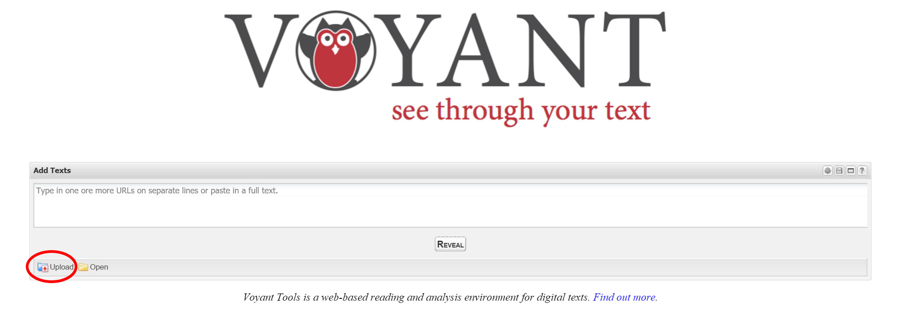
http://voyant-tools.org/

Slide 6
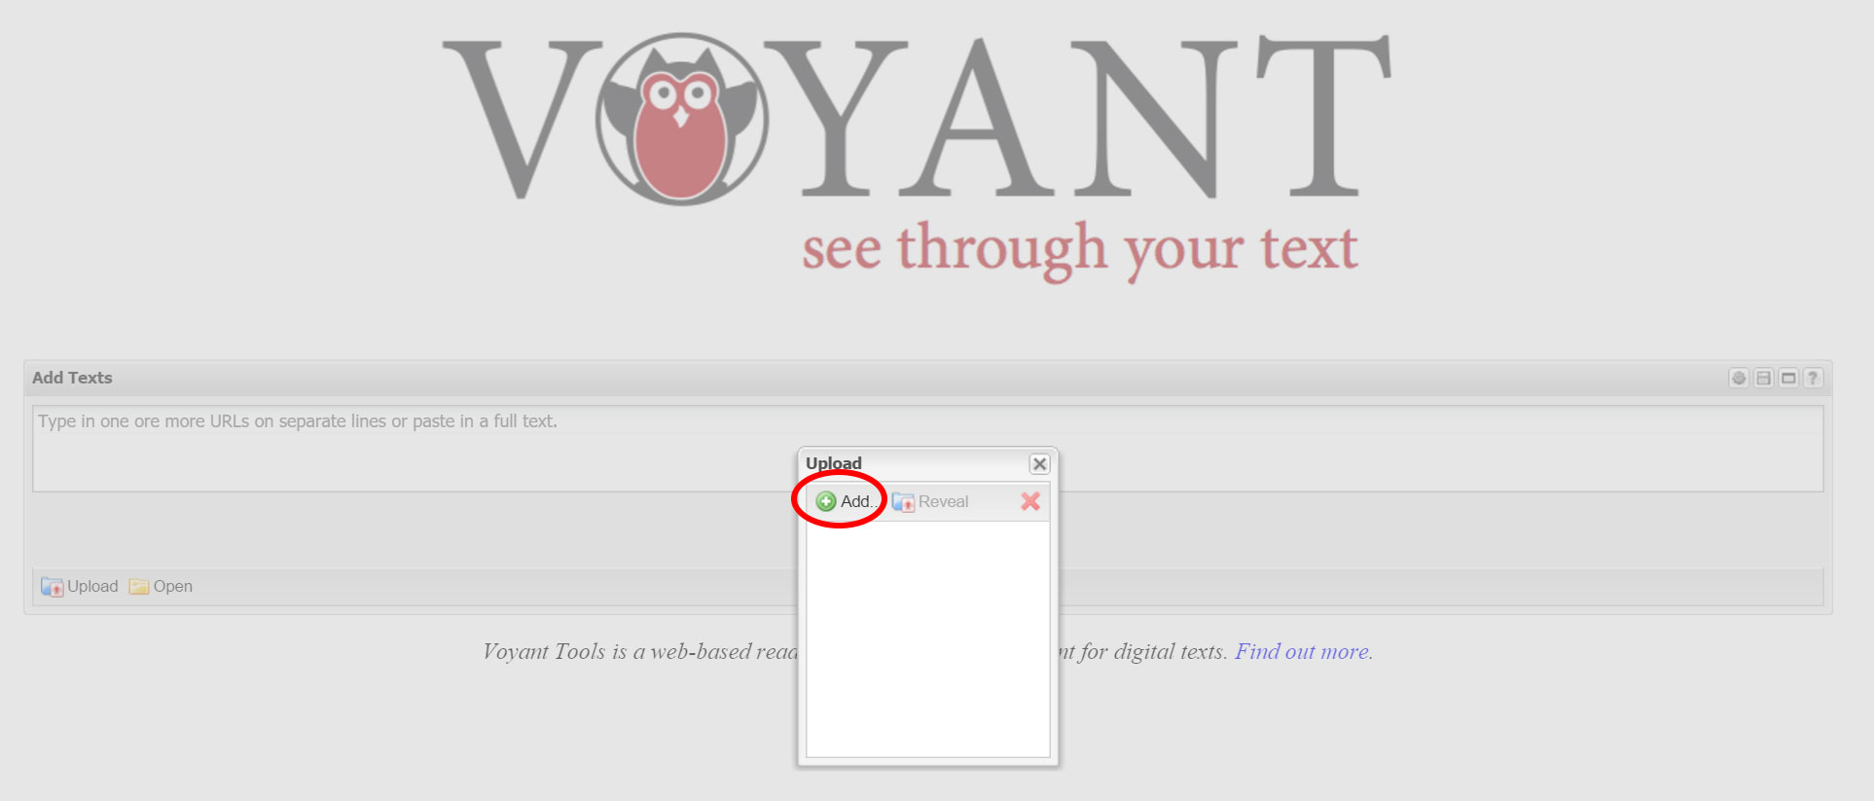
http://voyant-tools.org/

Slide 7
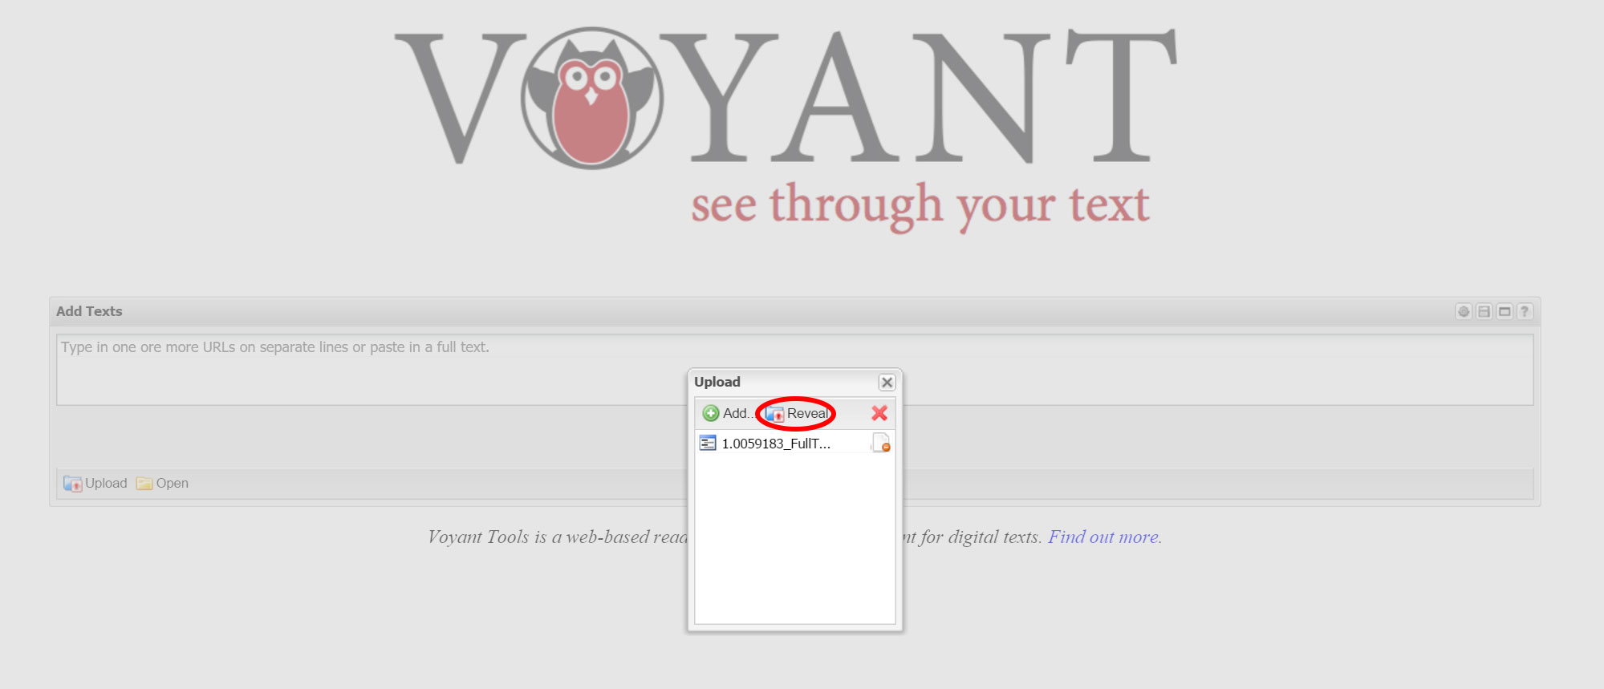
http://voyant-tools.org/

Slide 8
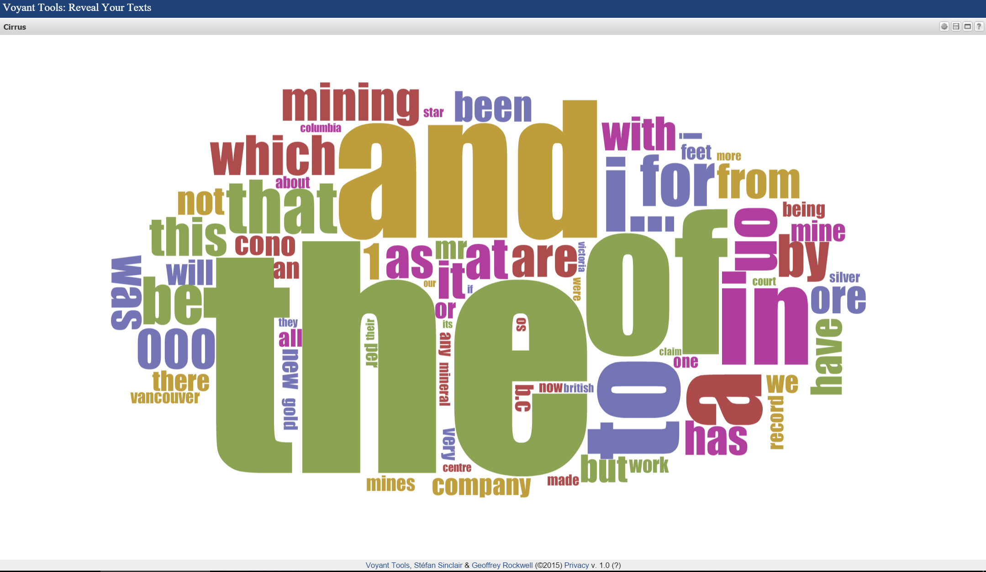
http://voyant-tools.org/

Slide 9

http://voyant-tools.org/

Slide 10
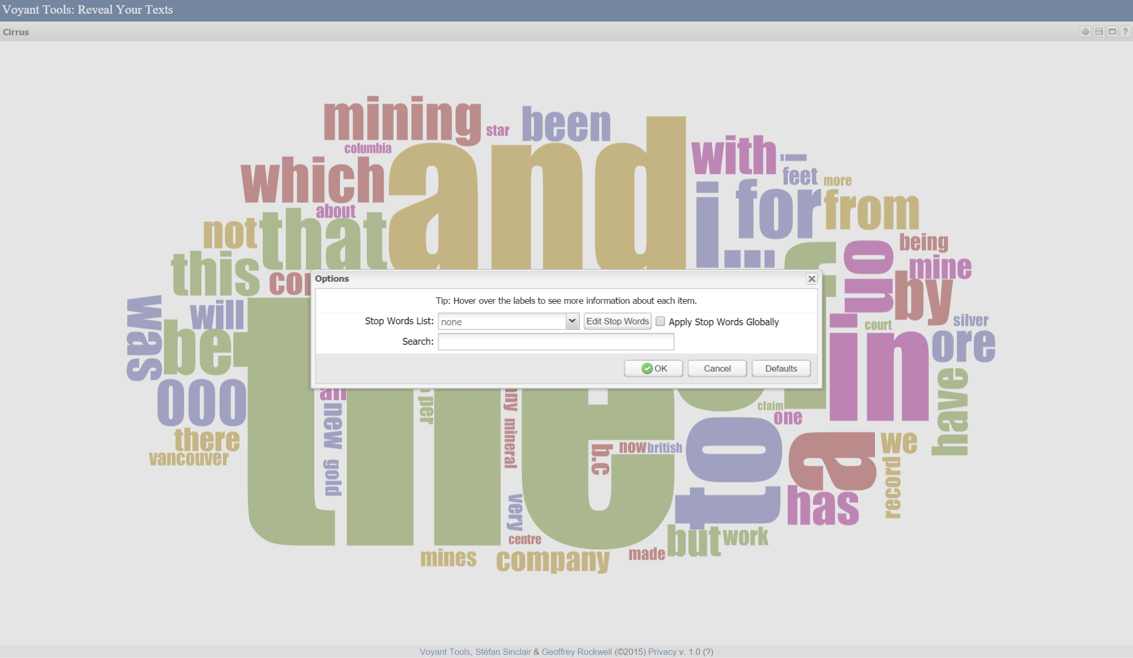
http://voyant-tools.org/

Slide 11
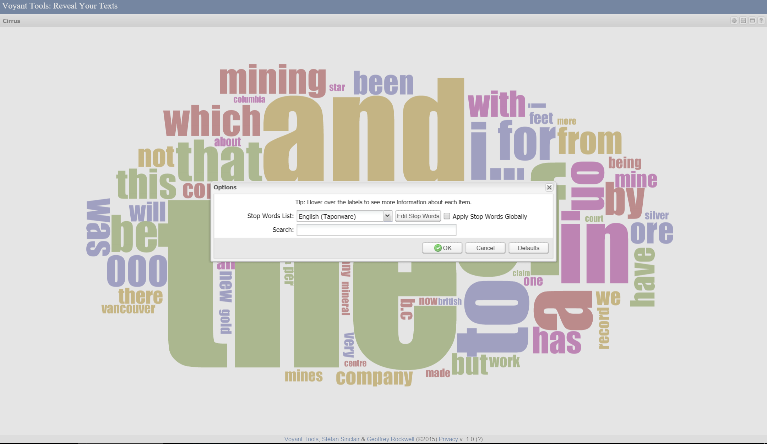
http://voyant-tools.org/

Slide 12
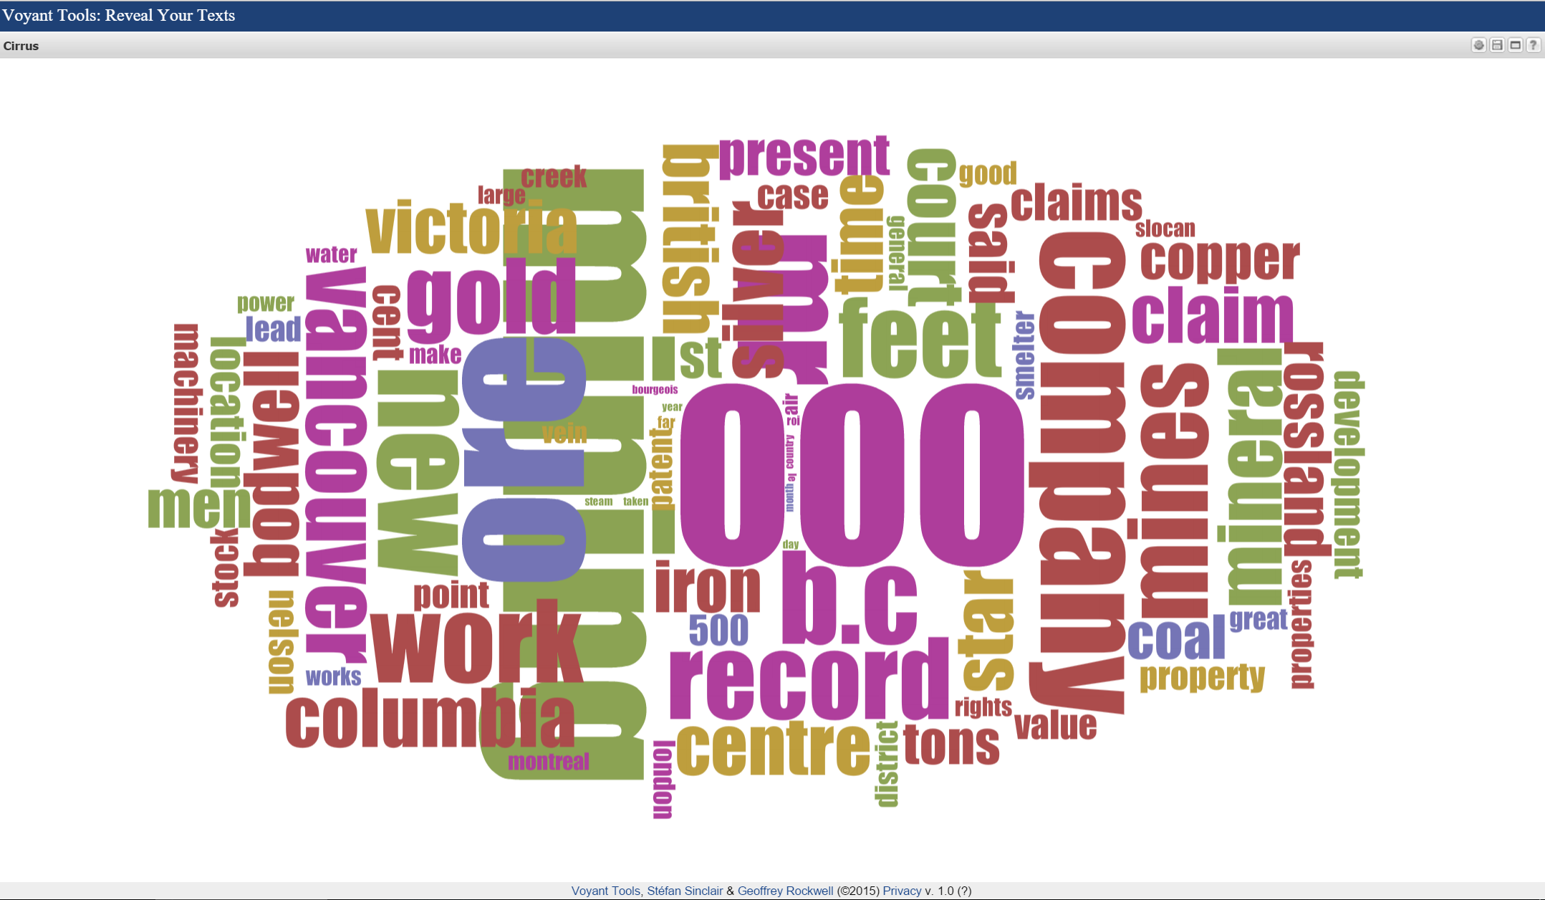
http://voyant-tools.org/

Slide 13
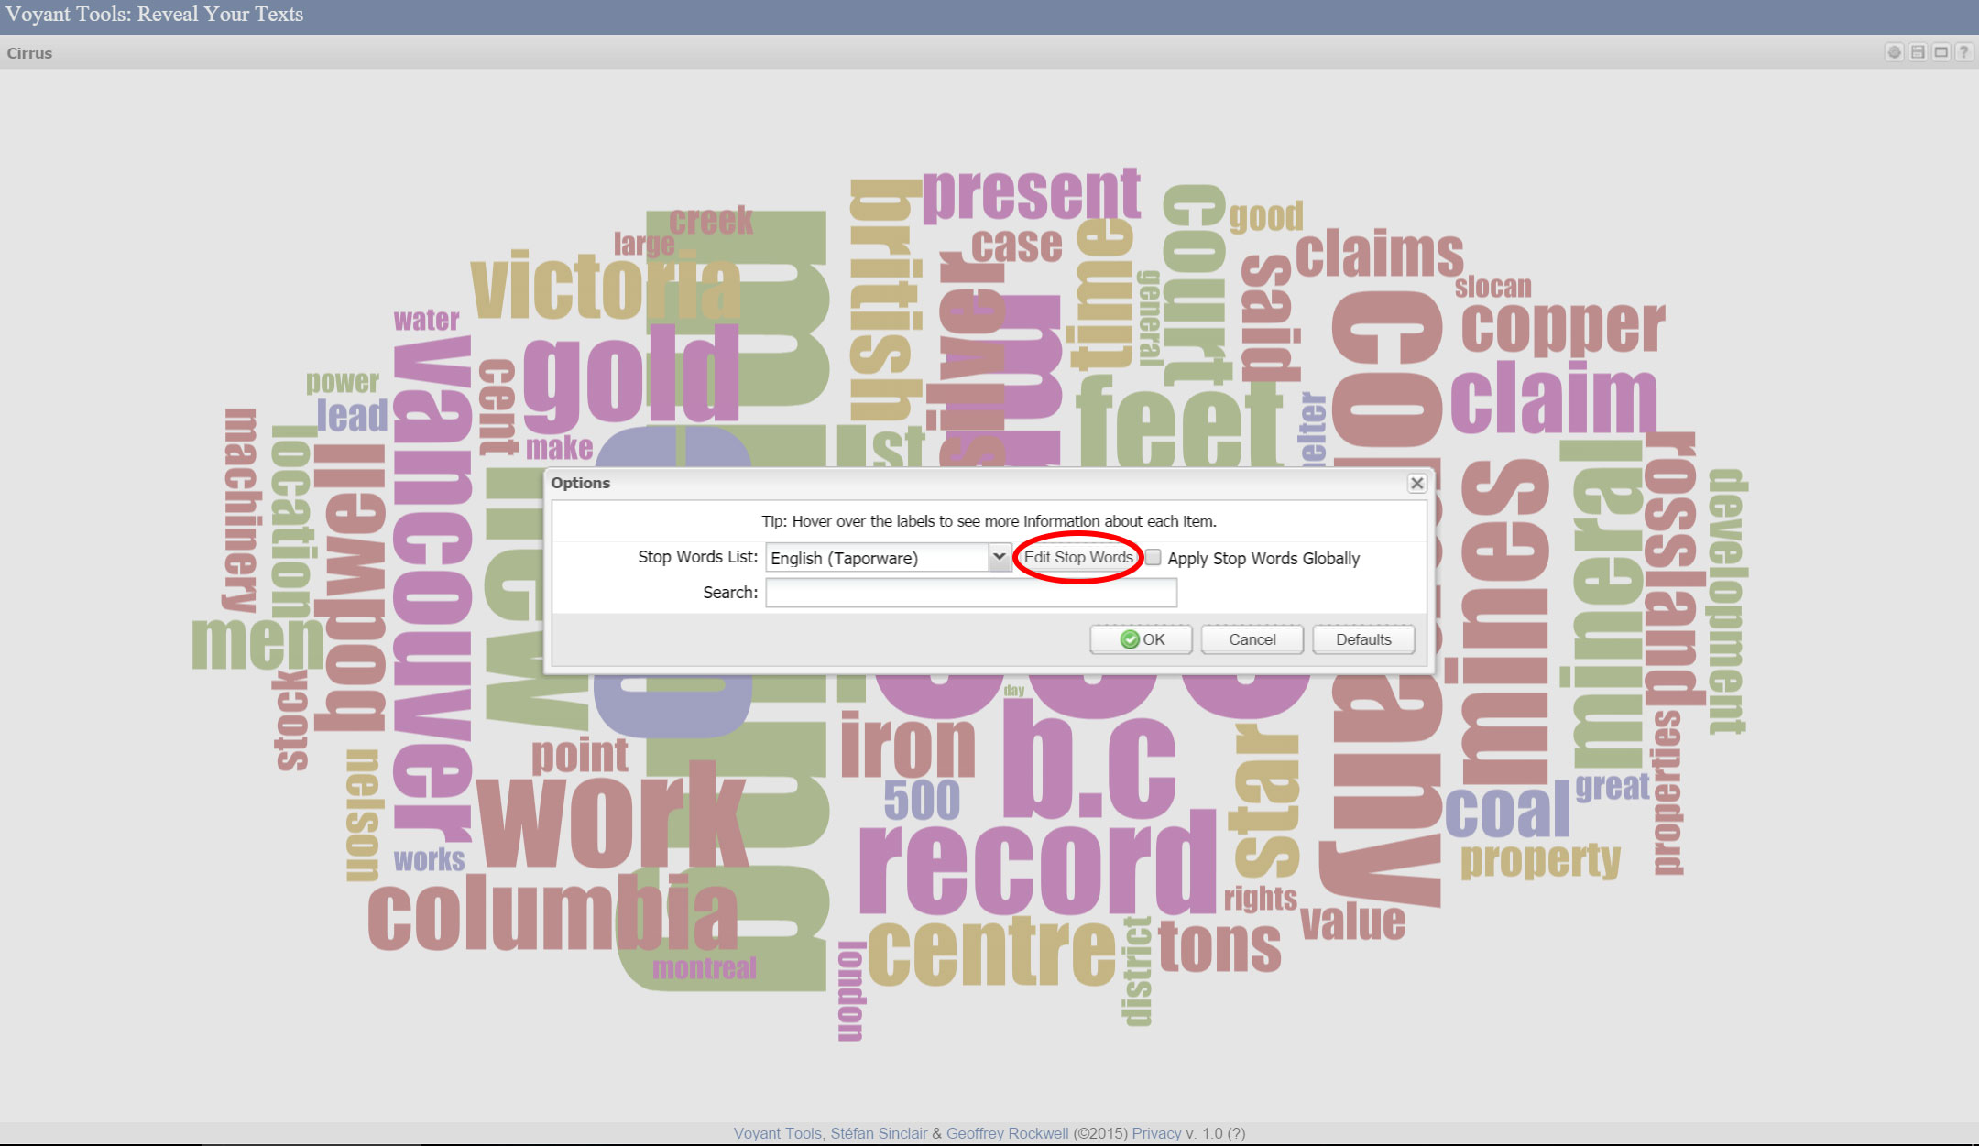
http://voyant-tools.org/

Slide 14
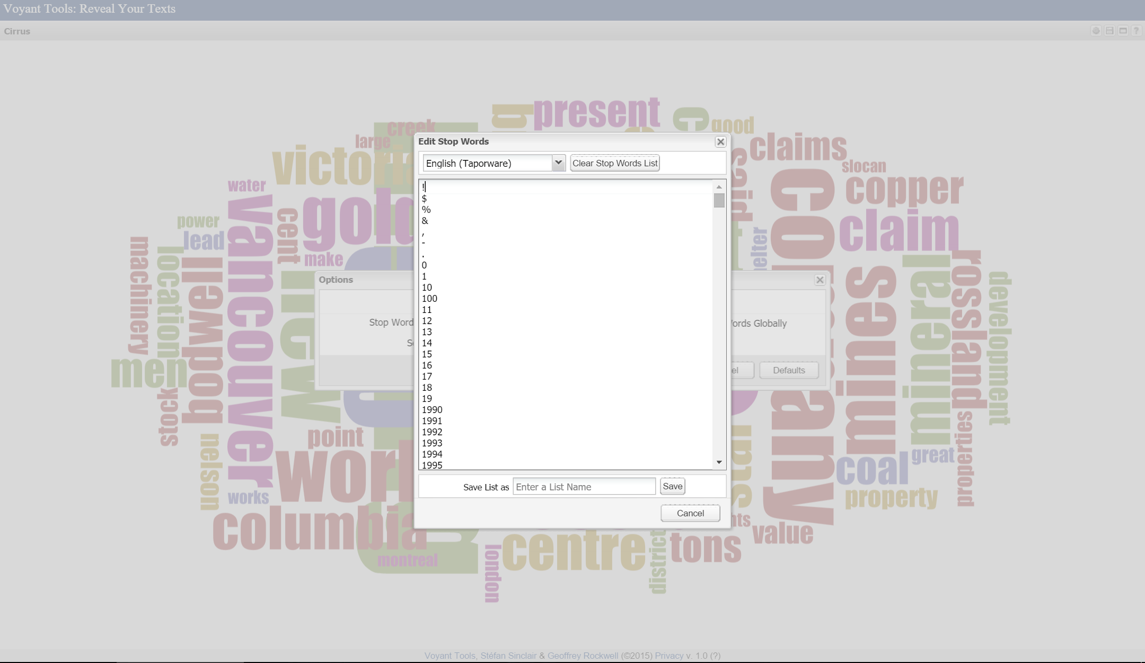
http://voyant-tools.org/

Slide 15
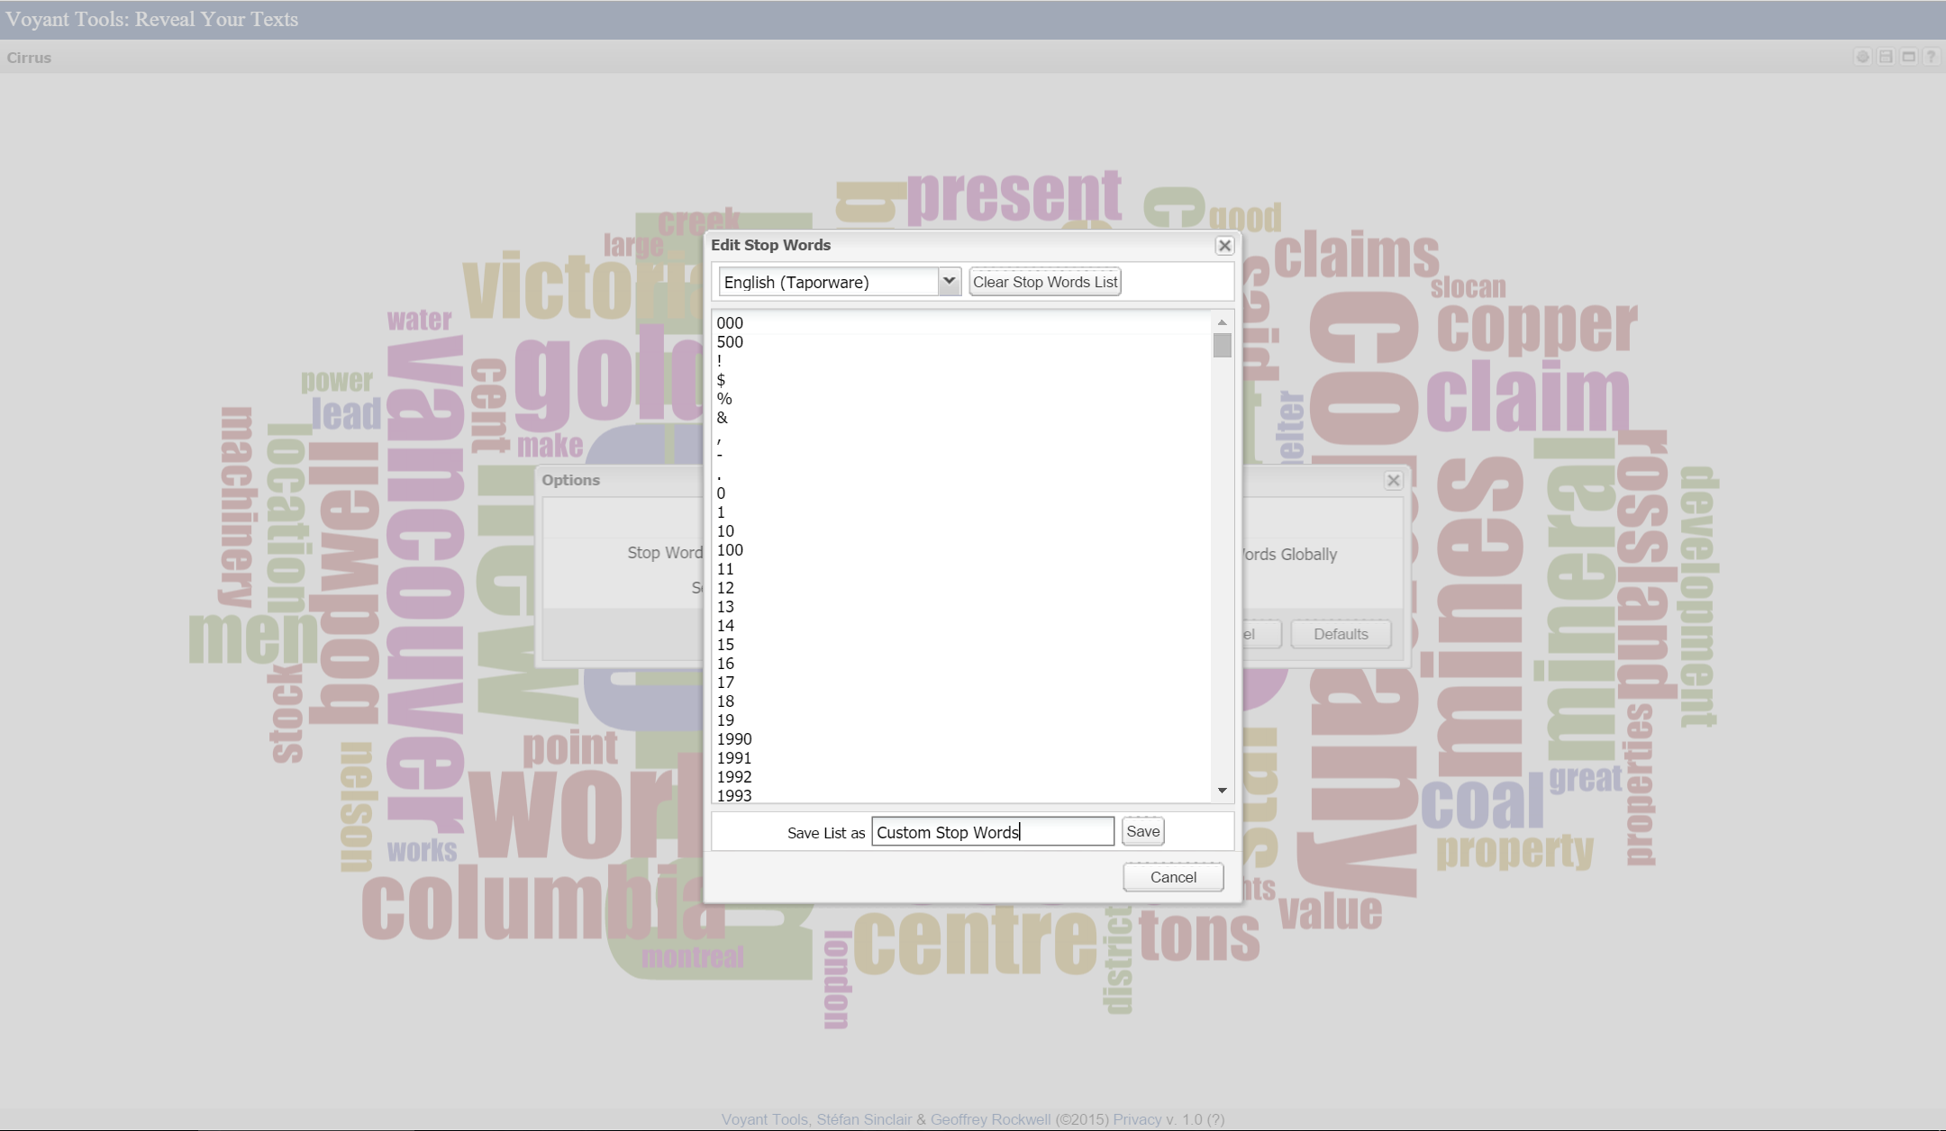
http://voyant-tools.org/
Notes:
Add ‘000’ and ‘500’ as stop words

Slide 16
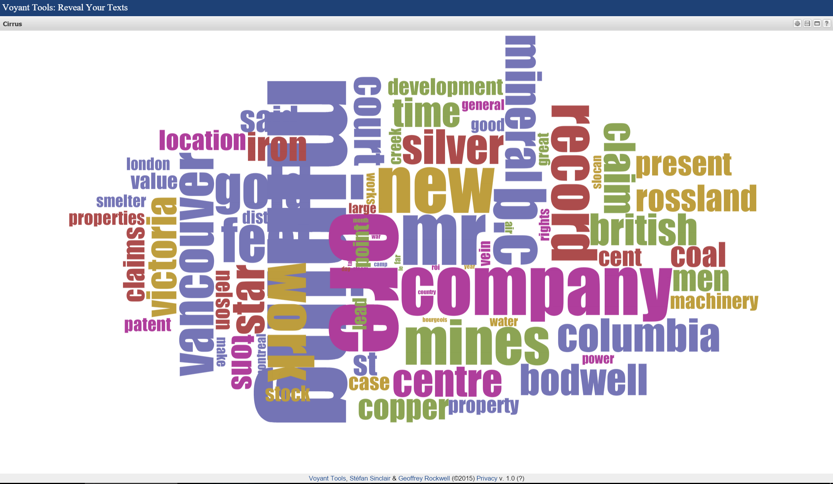
http://voyant-tools.org/

Slide 17
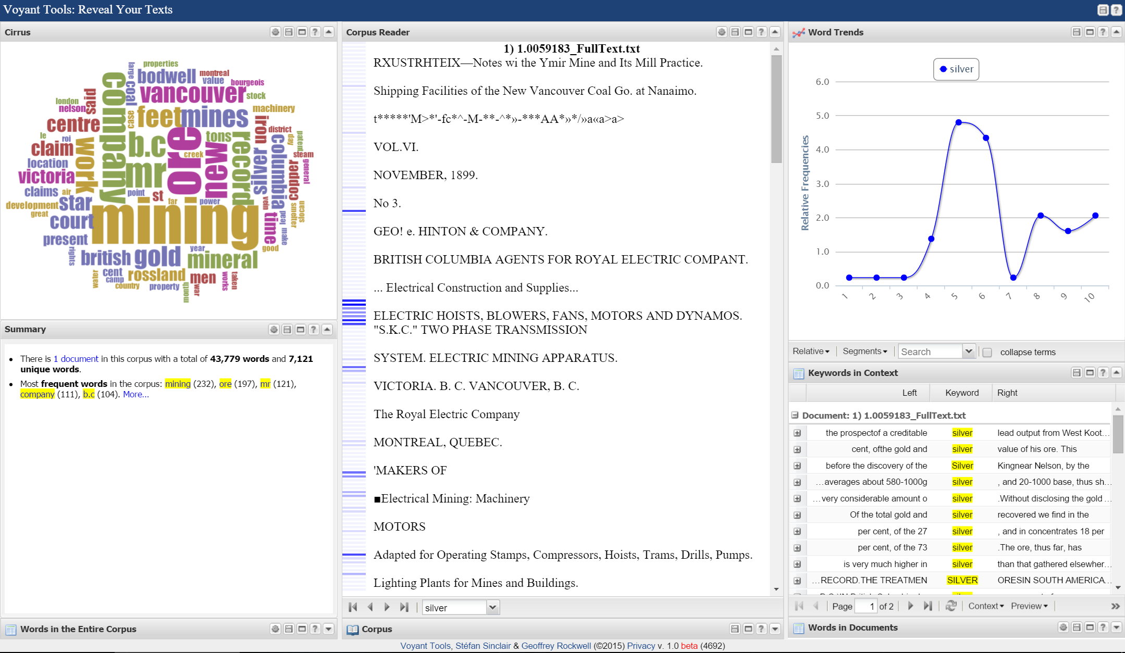

Slide 18
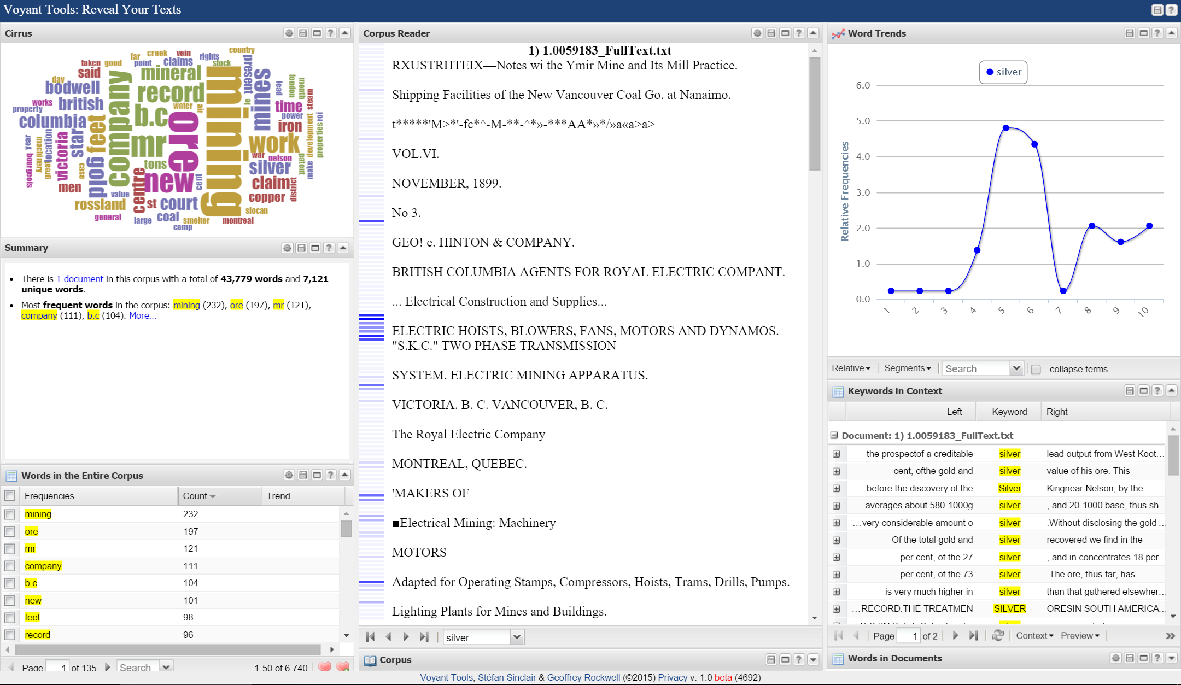

Slide 19
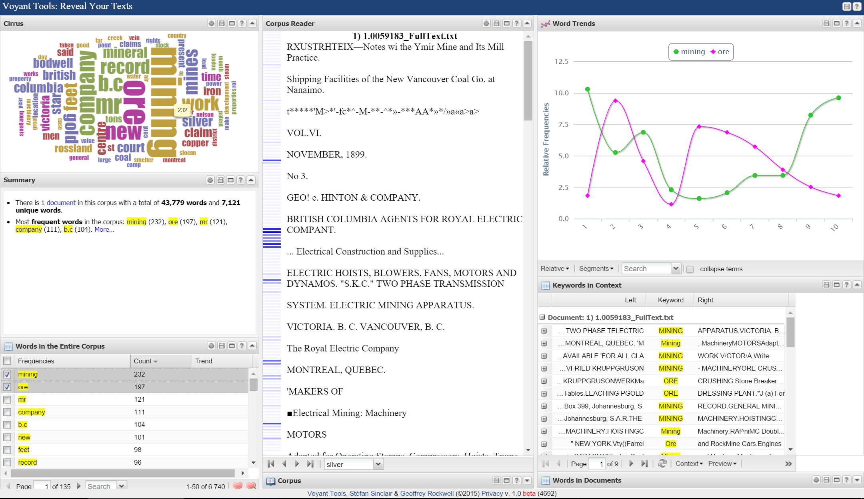

Slide 20
Full Text Analysis using AntConc
A freeware corpus analysis toolkit for concordancing and text analysis.
Can handle larger amounts of Full Text than Cirrus.
Some of the more advanced features can be slow depending on your computer’s processor.

Slide 21
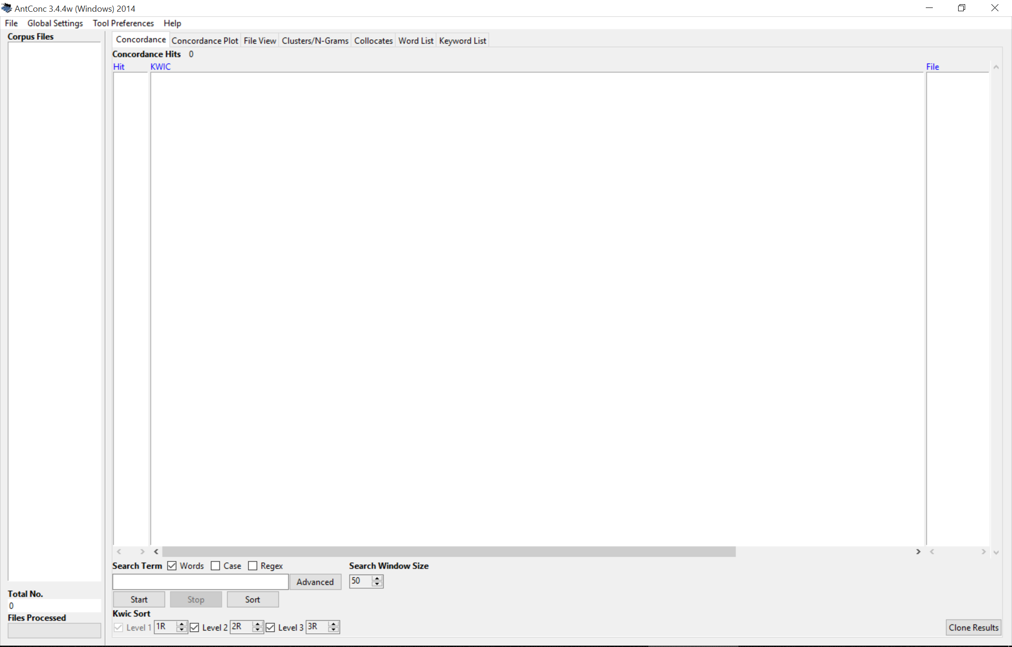

Slide 22
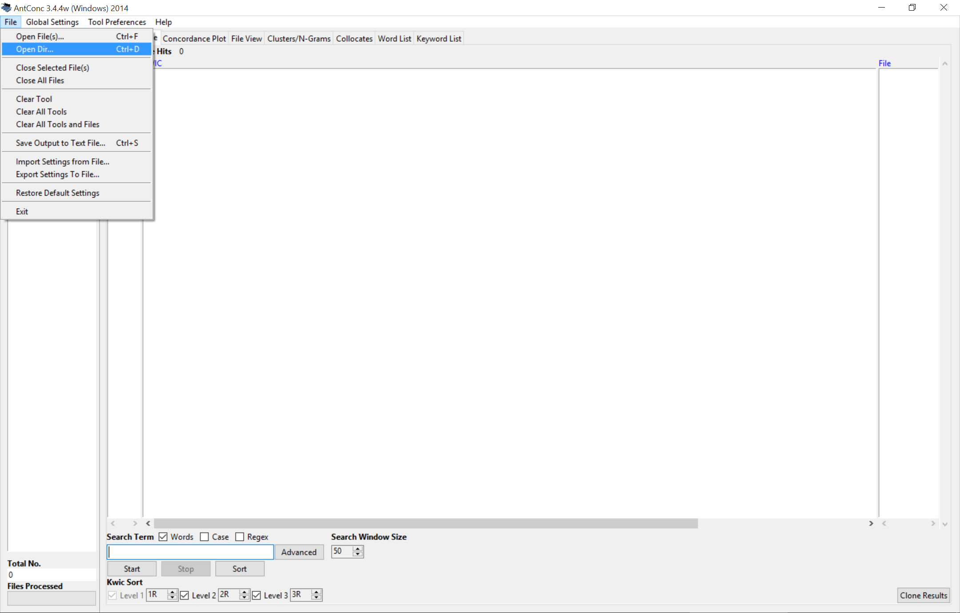

Slide 23
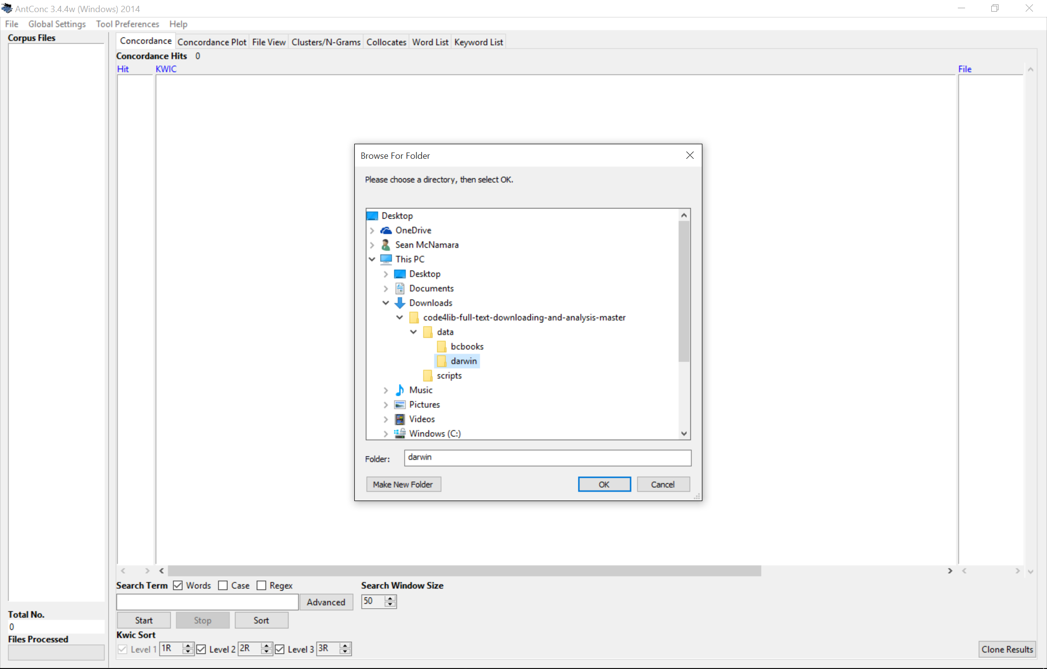

Slide 24
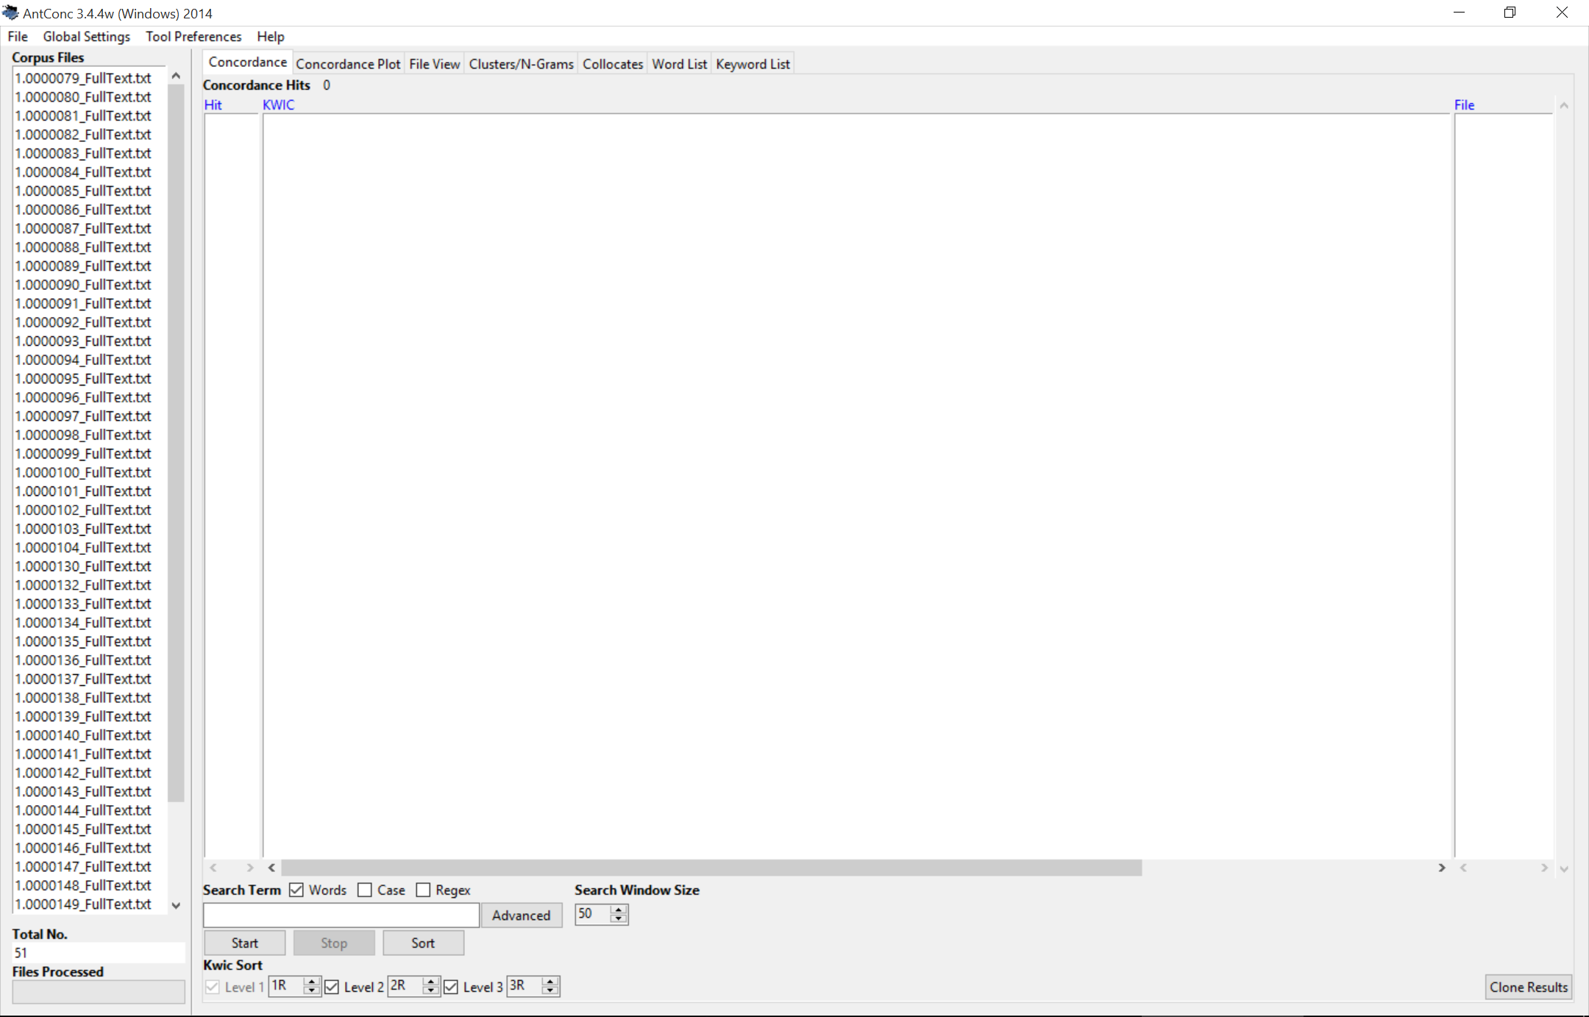

Slide 25
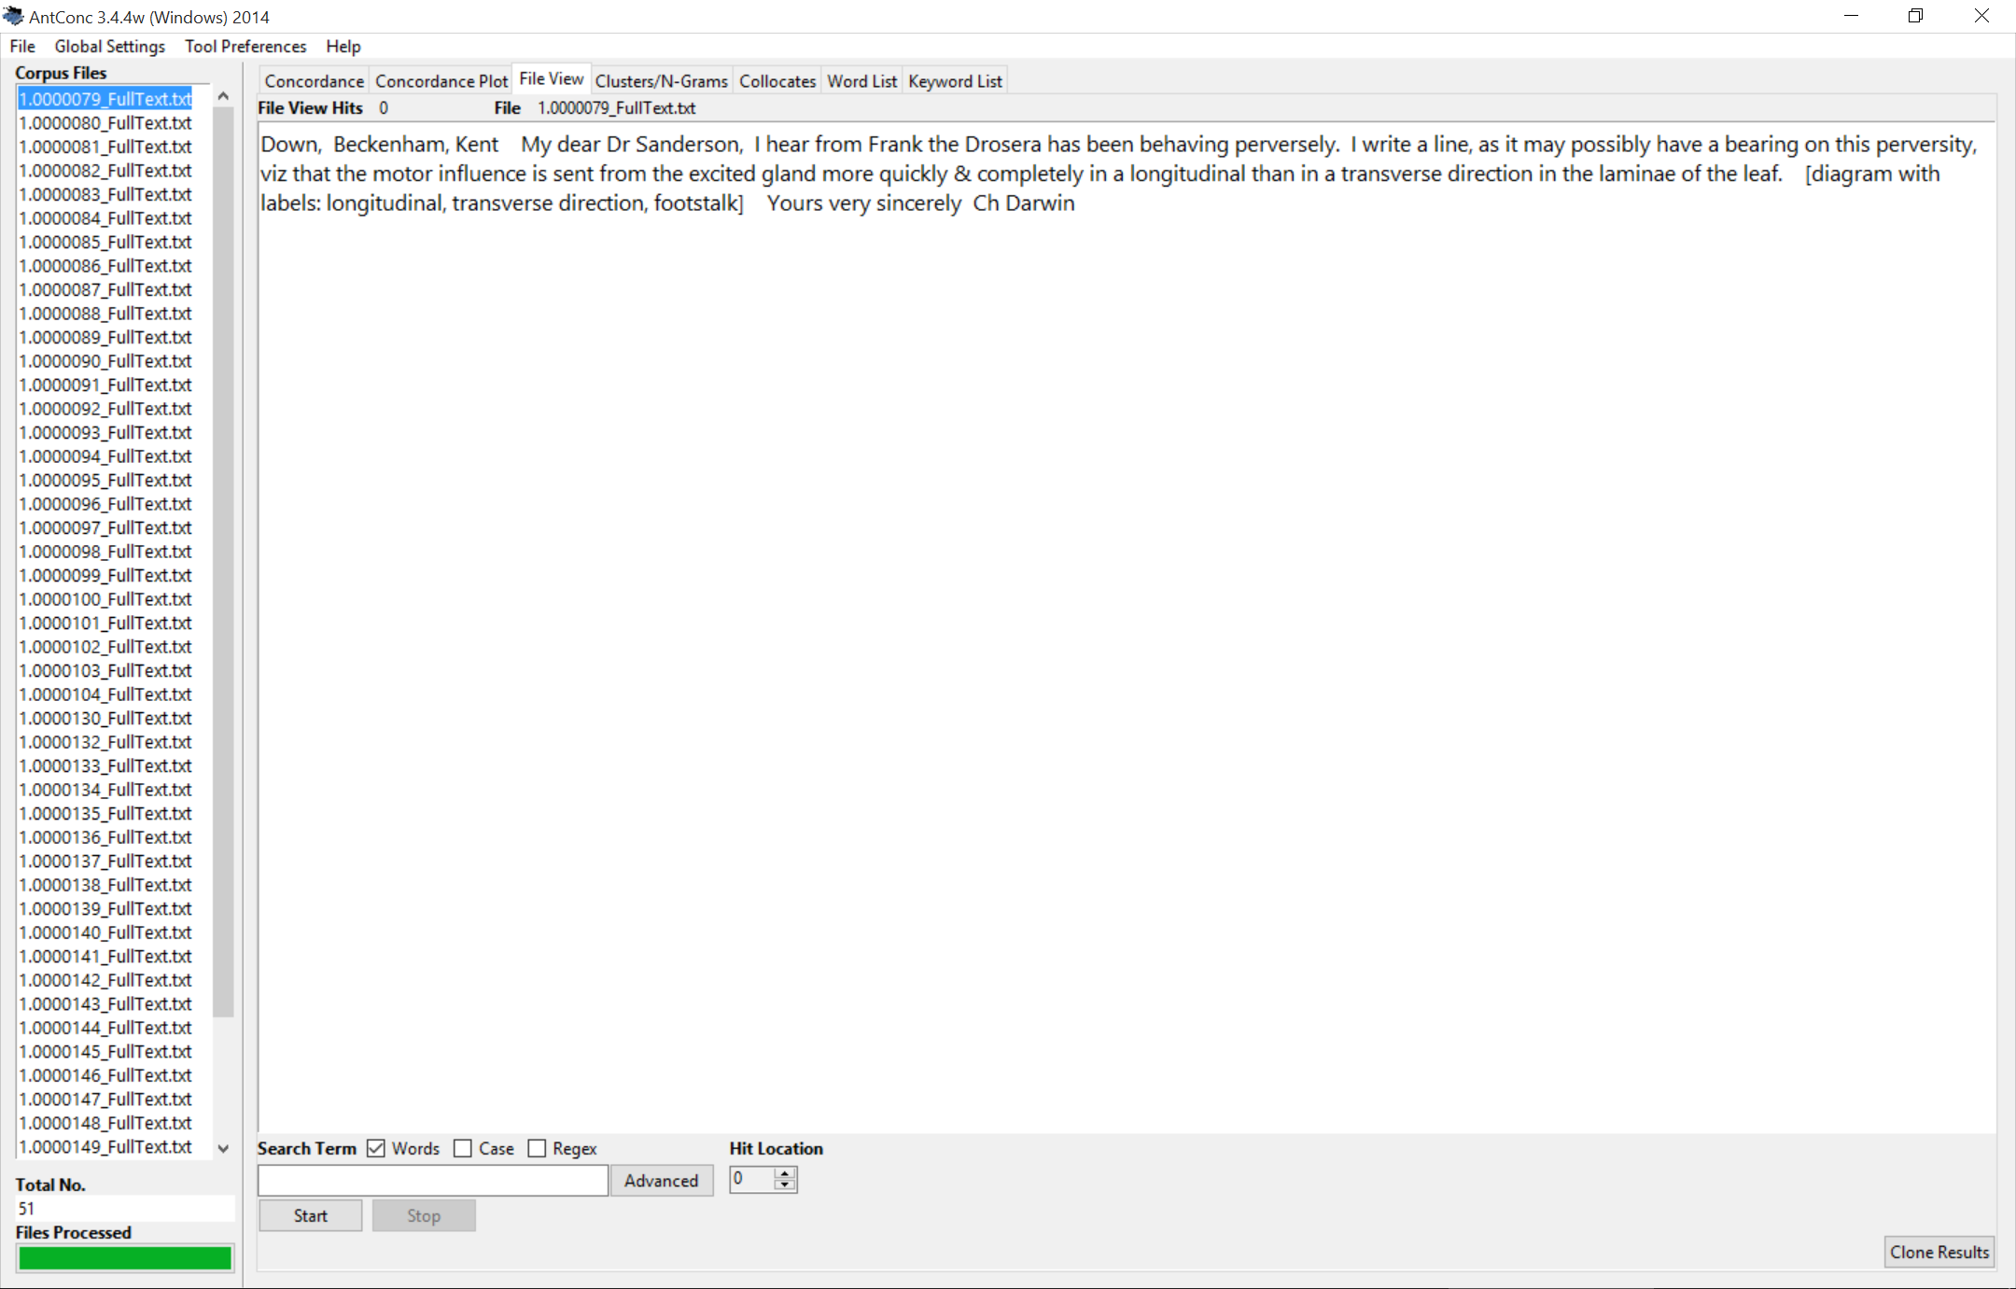

Slide 27
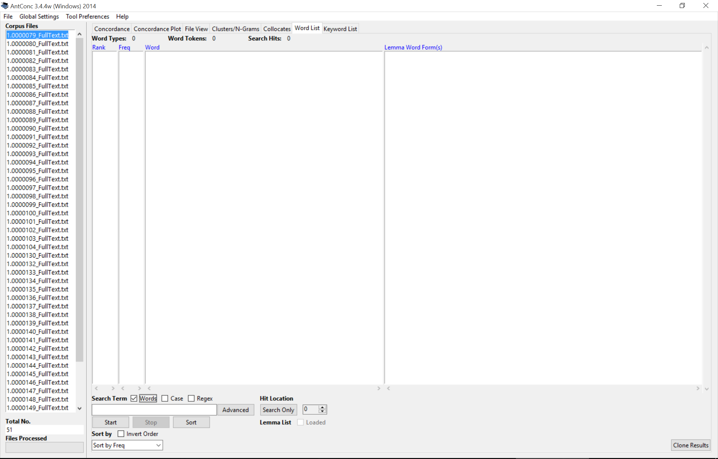

Slide 28
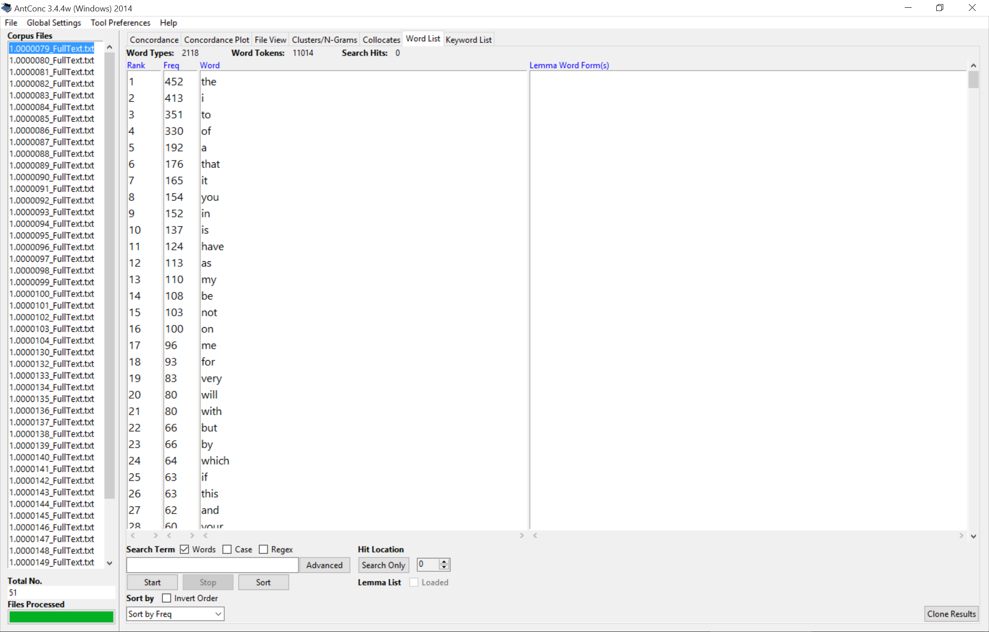

Slide 30
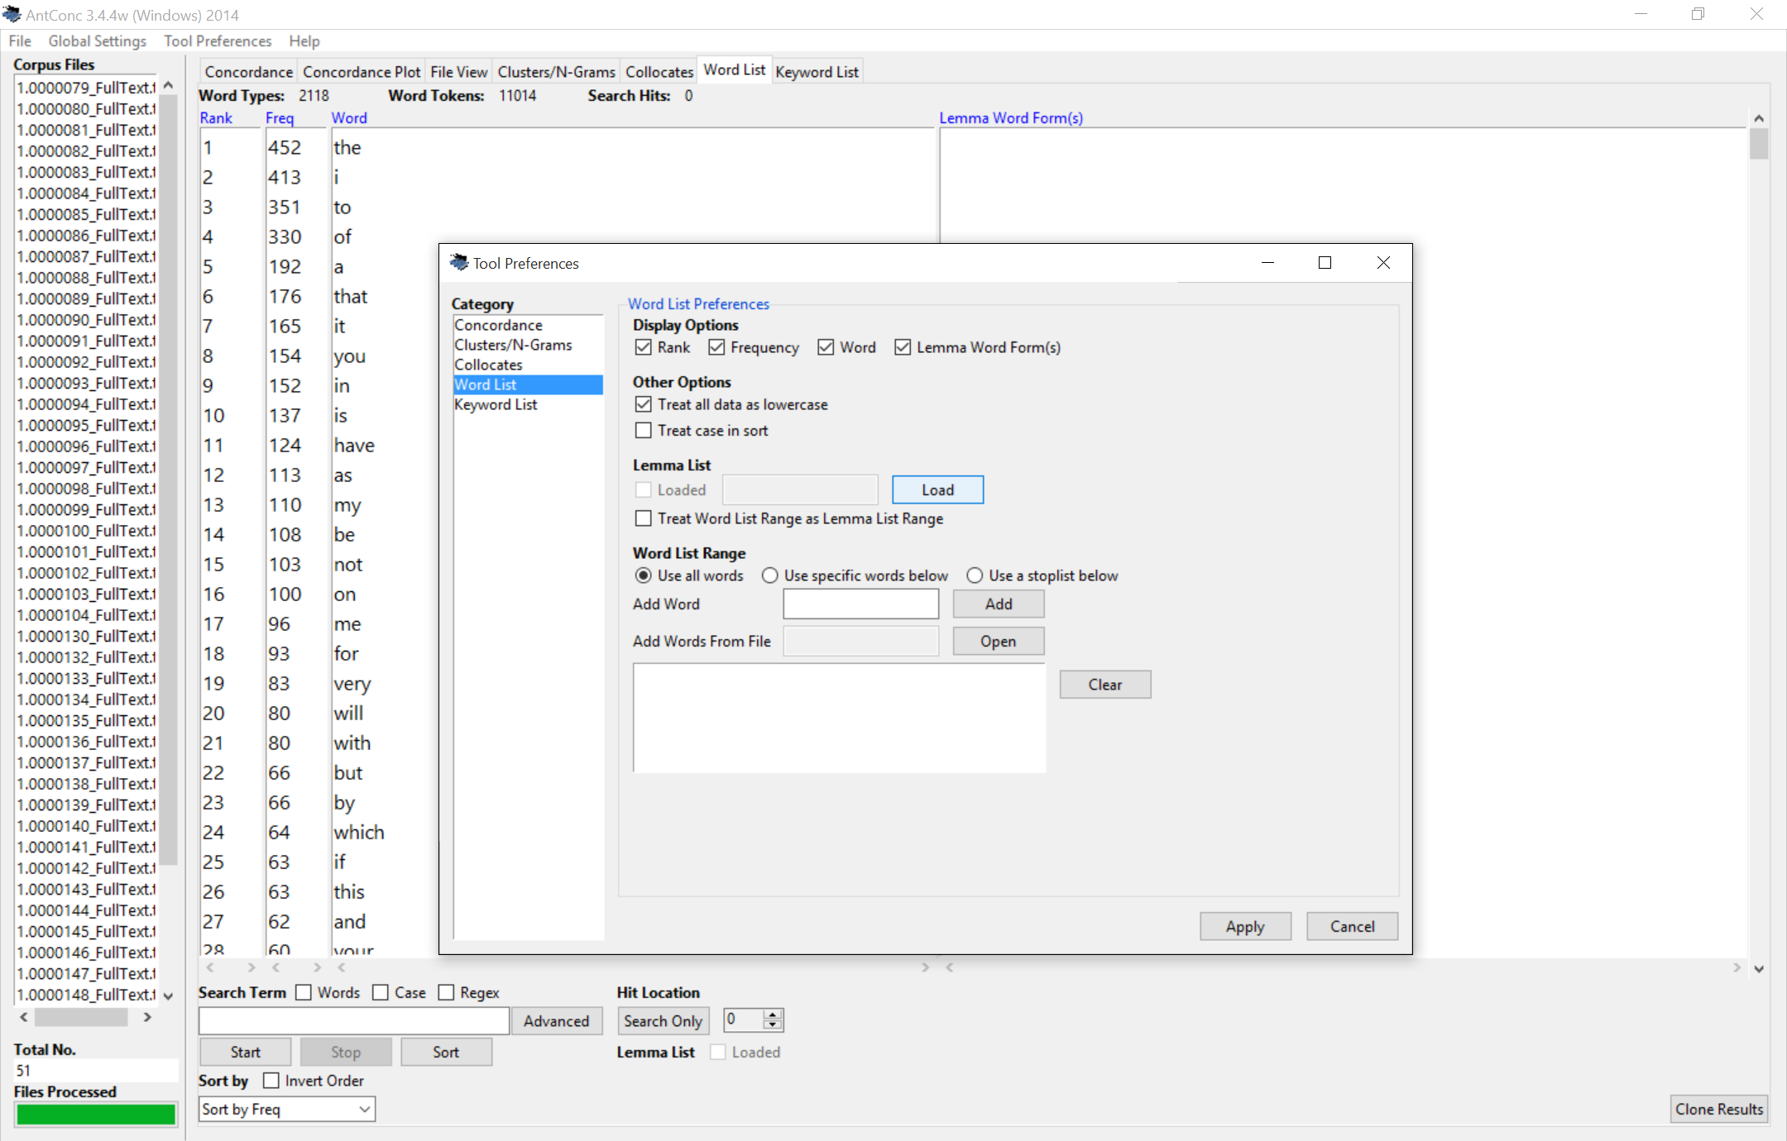

Slide 31
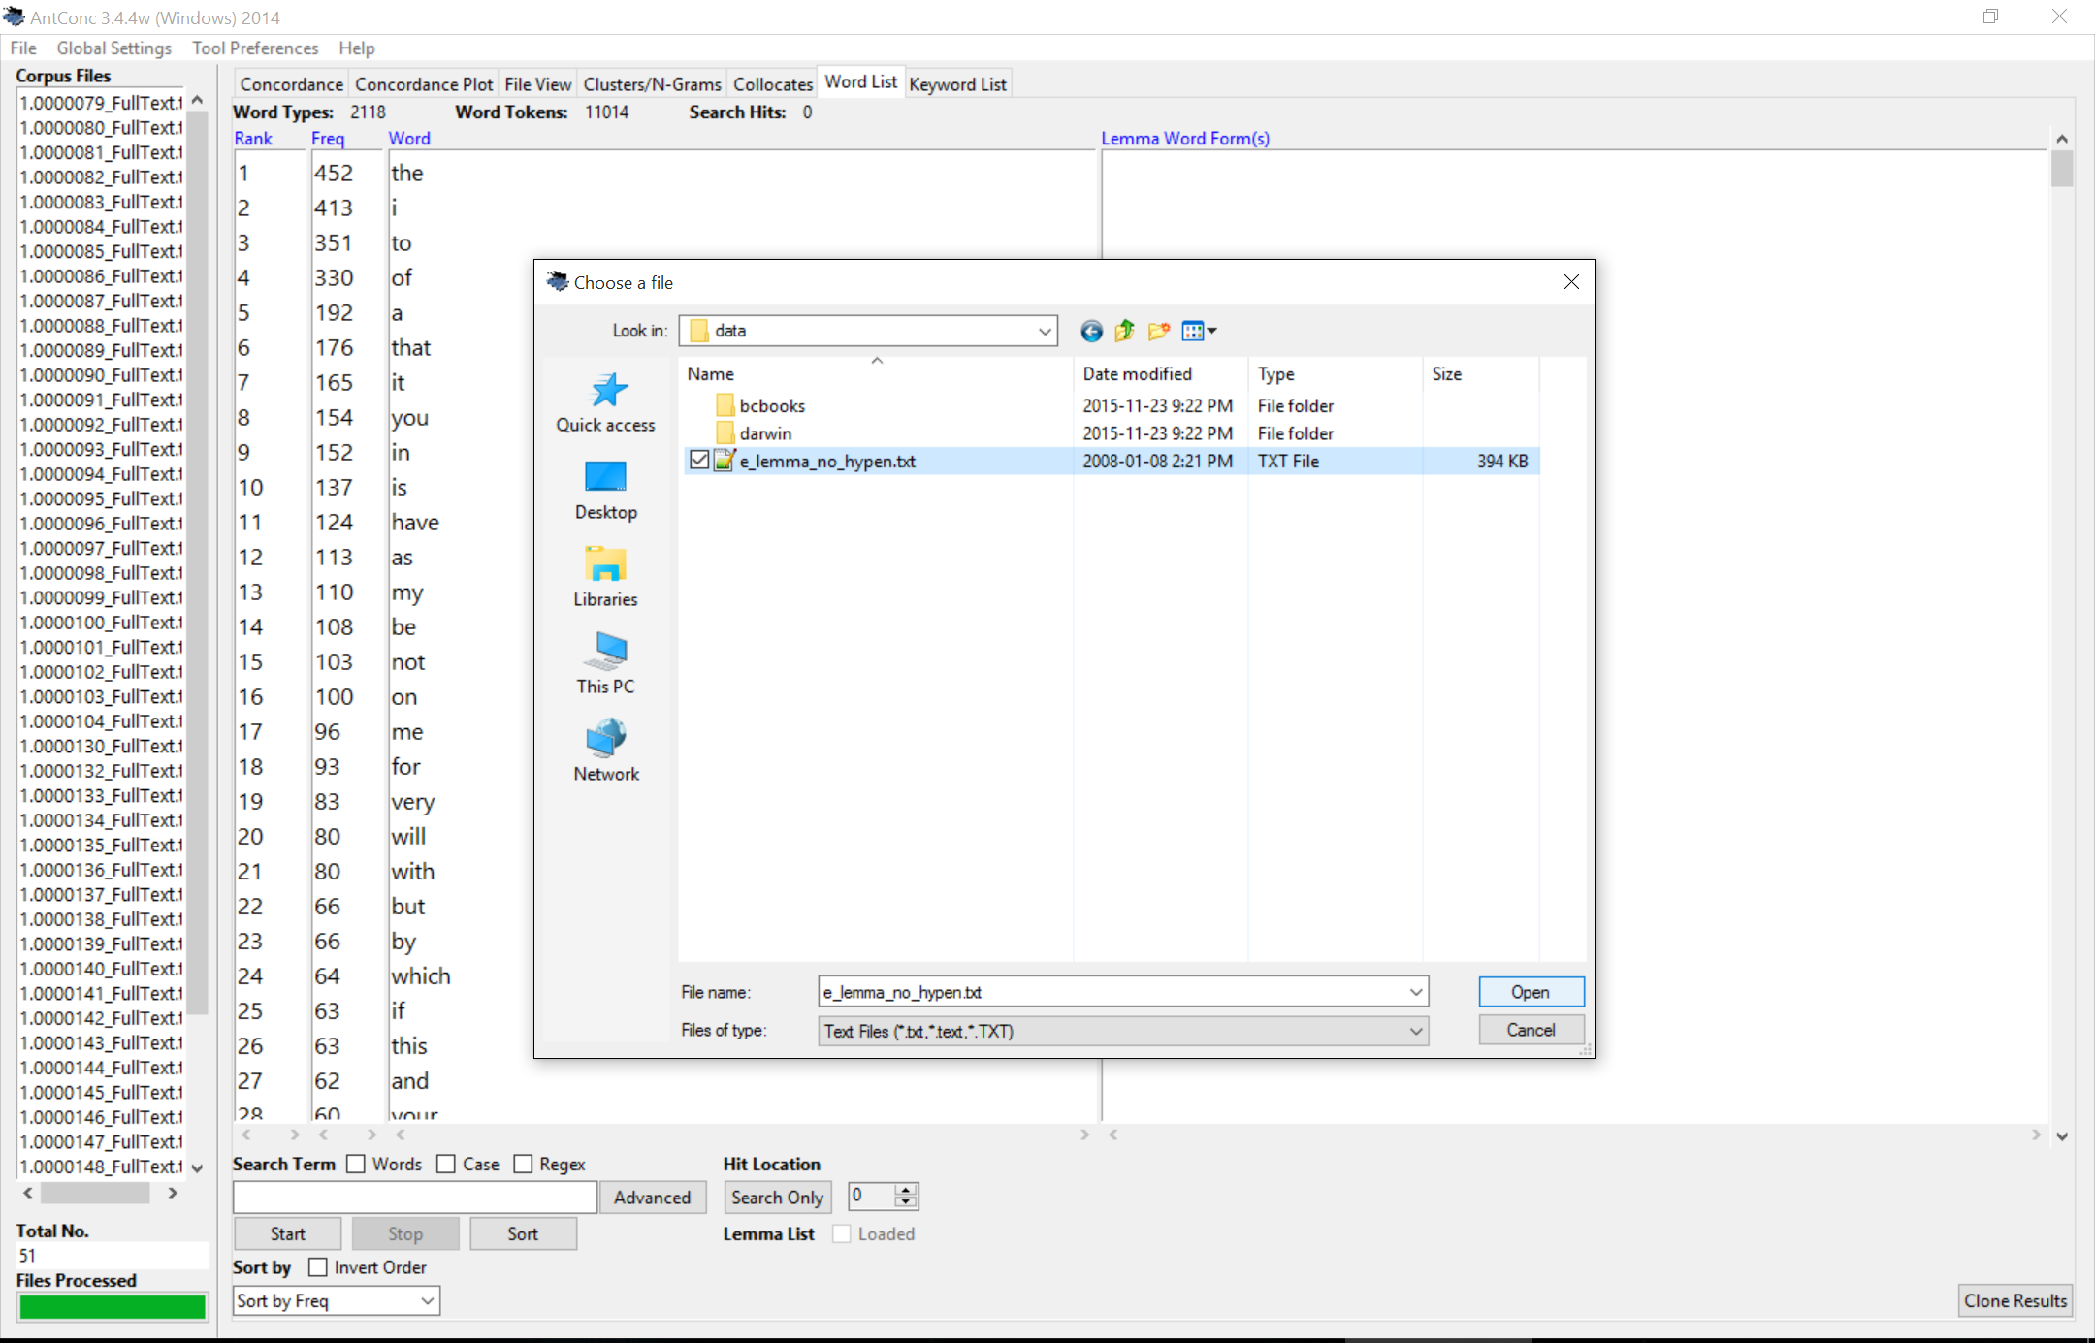

Slide 32
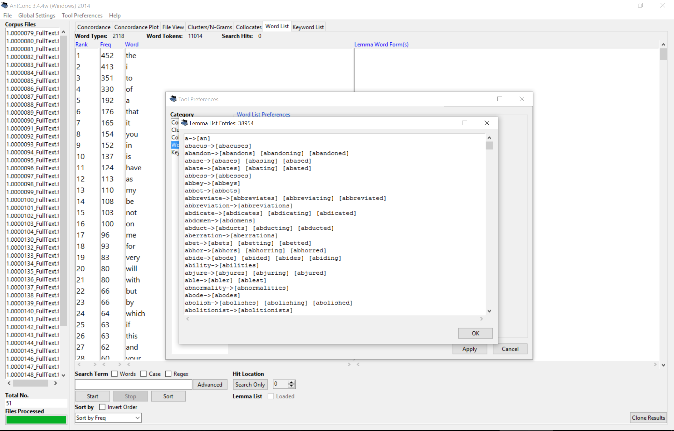

Slide 33


Slide 34
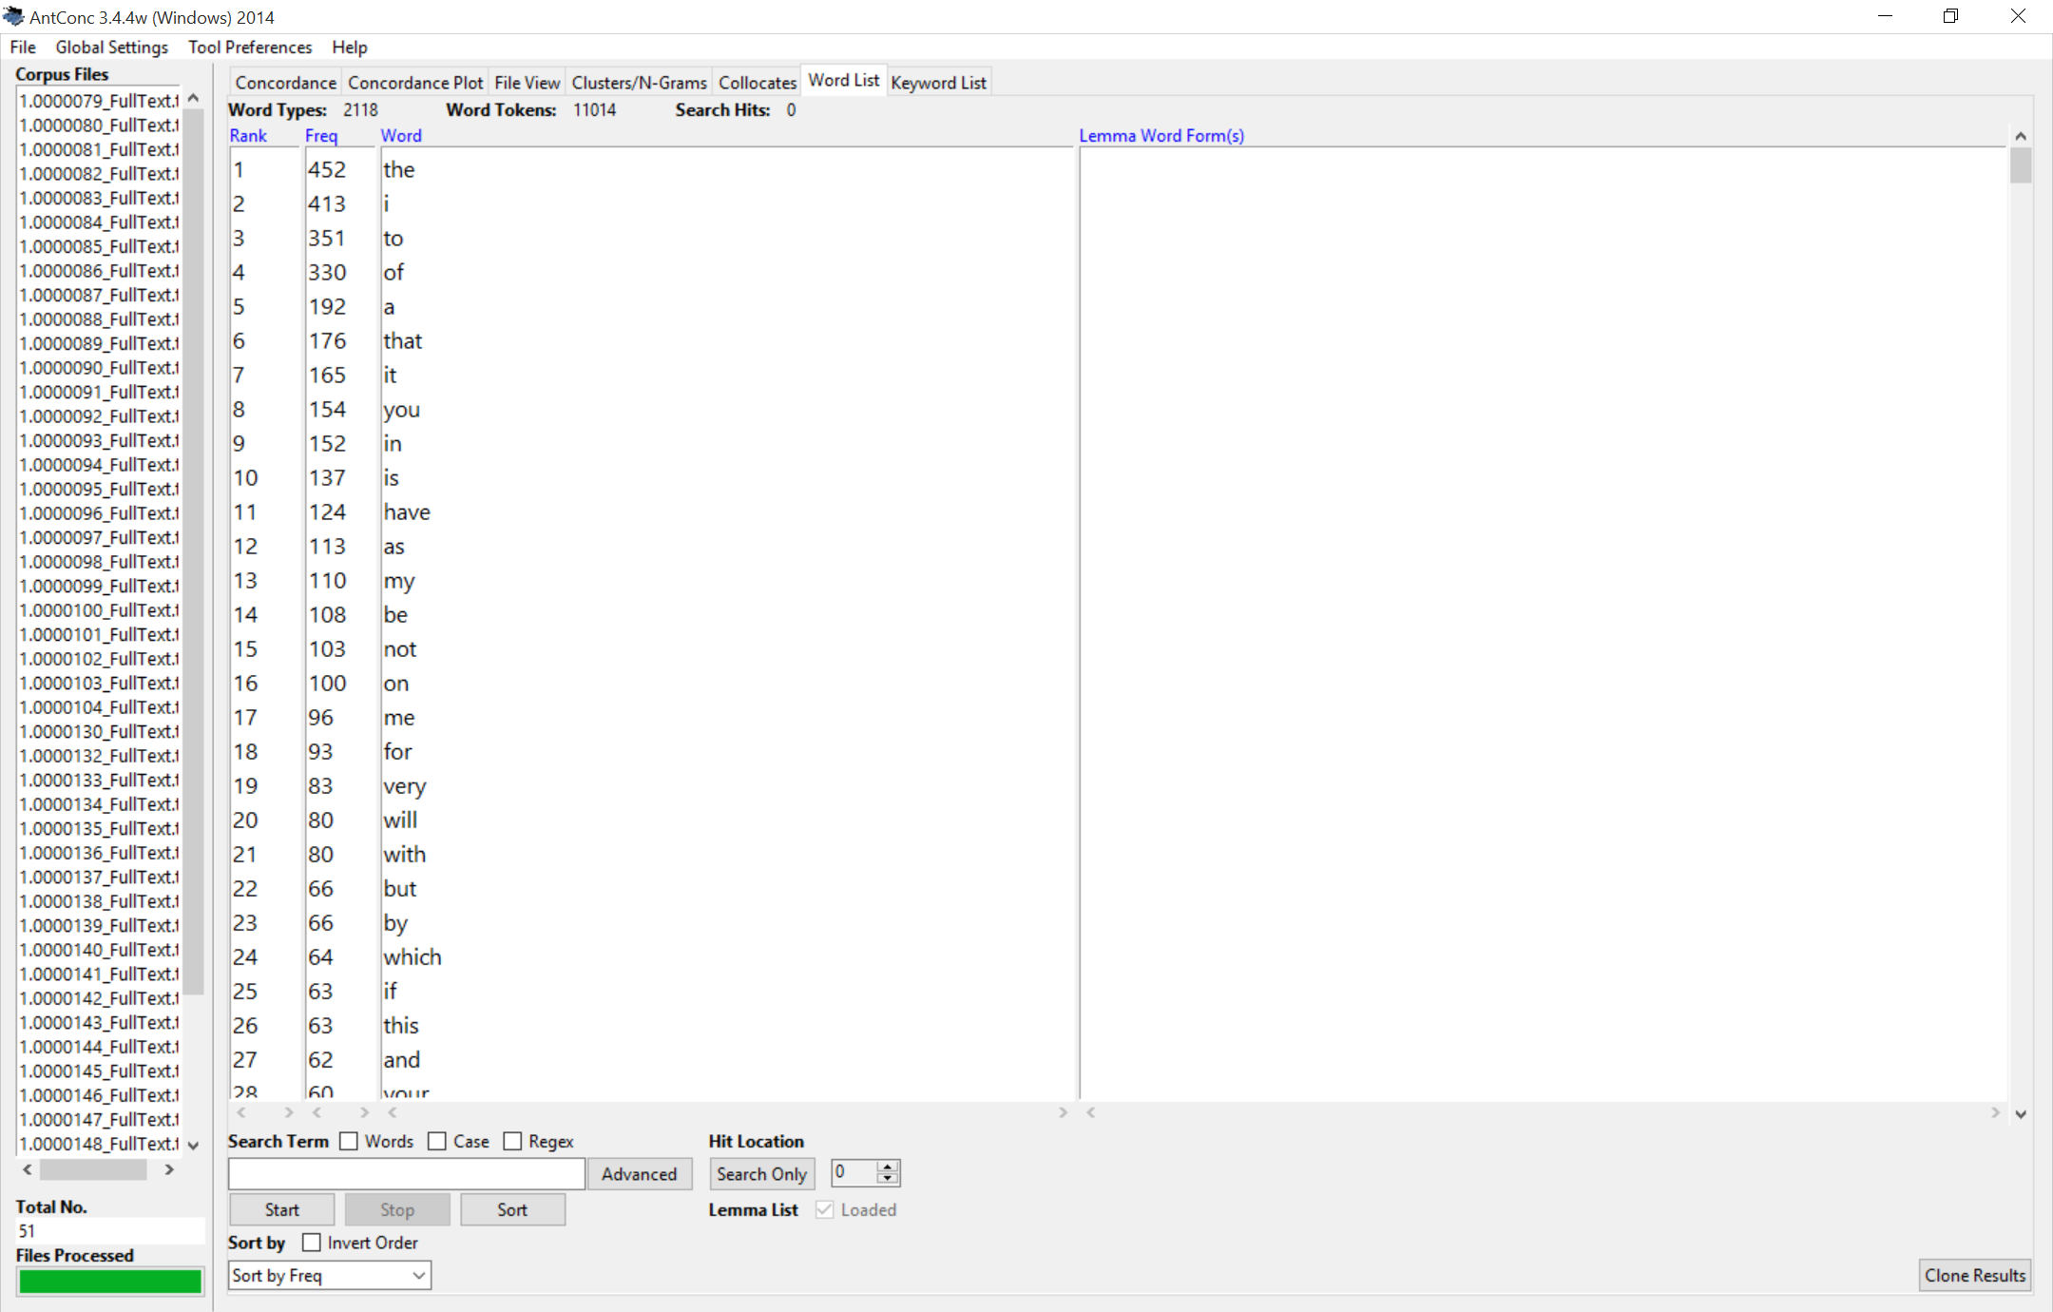

Slide 35
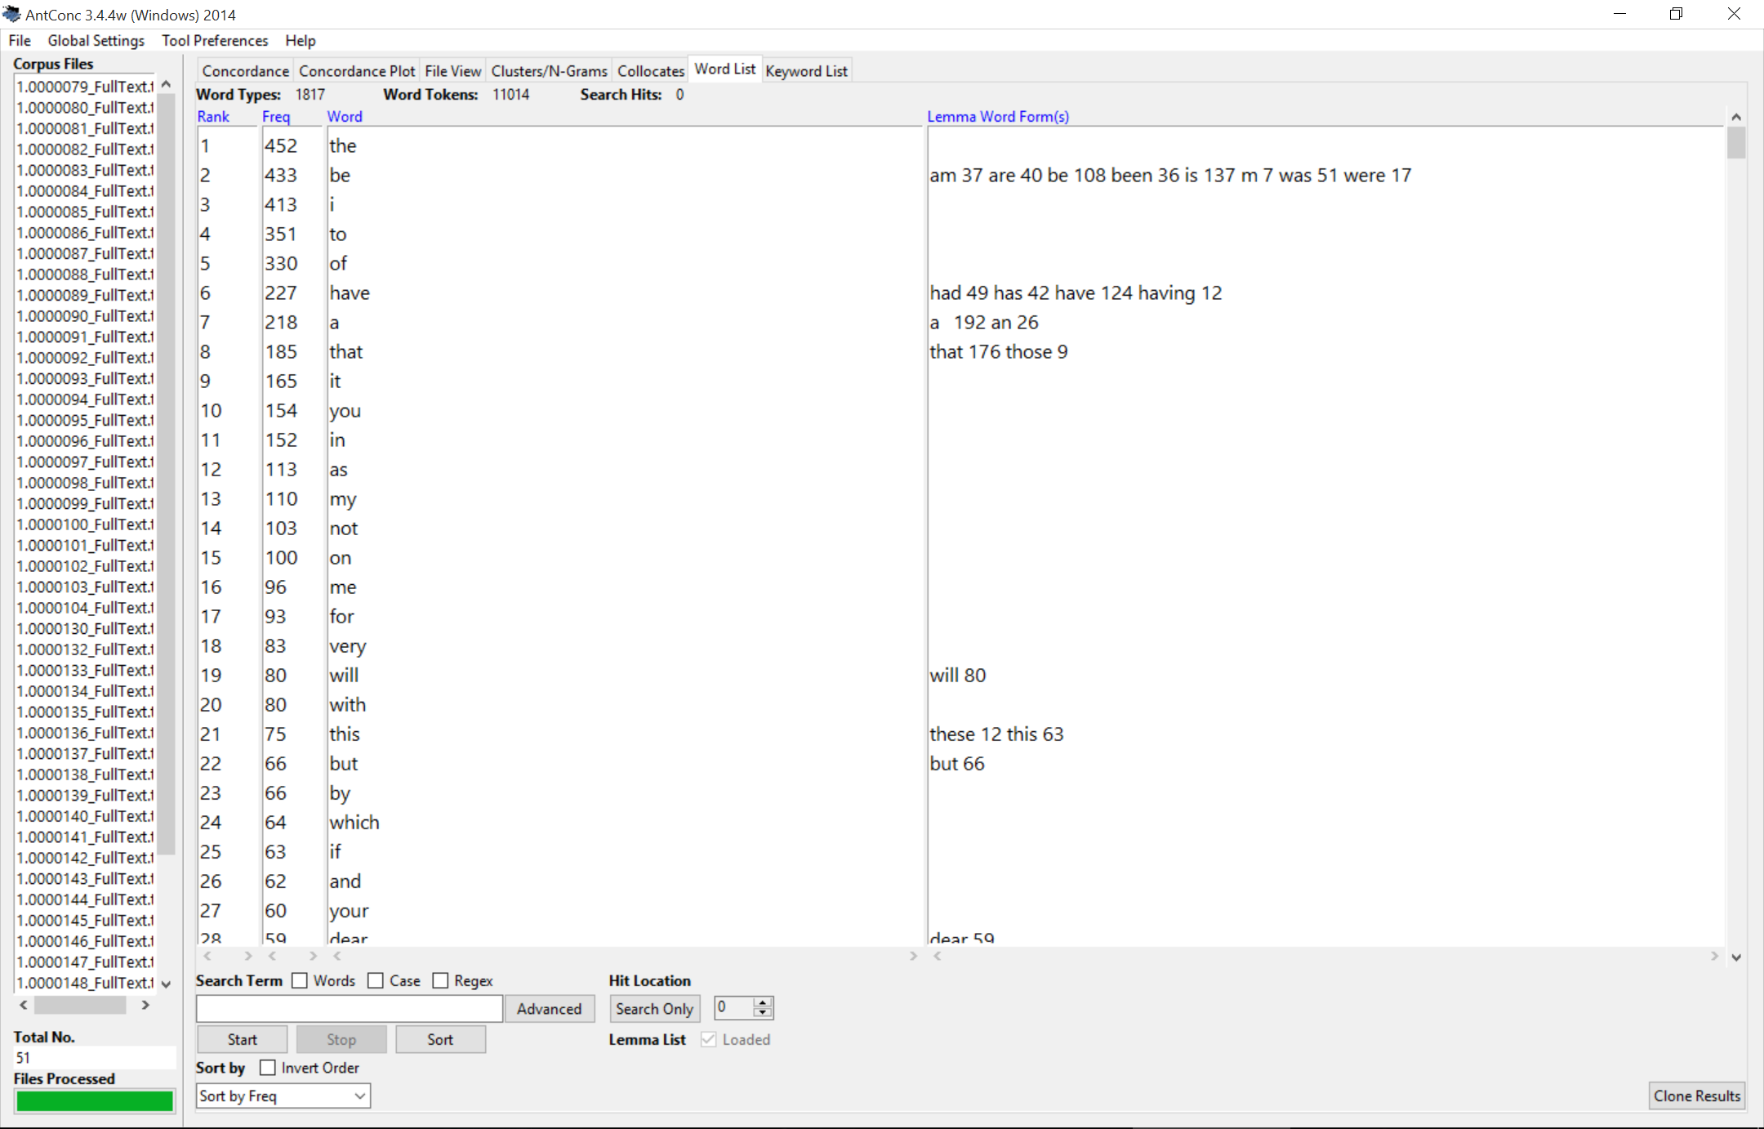
Notes:
Now we can choose a word!

Slide 36
Notes:
Now we can choose a word!

Slide 37
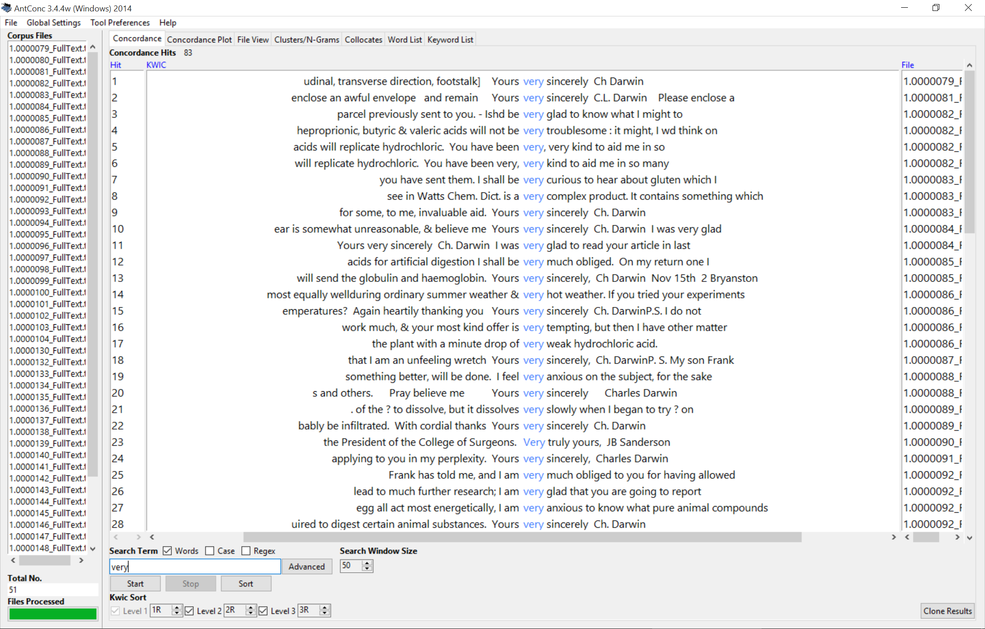
Notes:
Have our results but they are hard to read… so.. Not easy to see context word is being used in.

Slide 38
Notes:
We should click the sort button obviously!

Slide 39
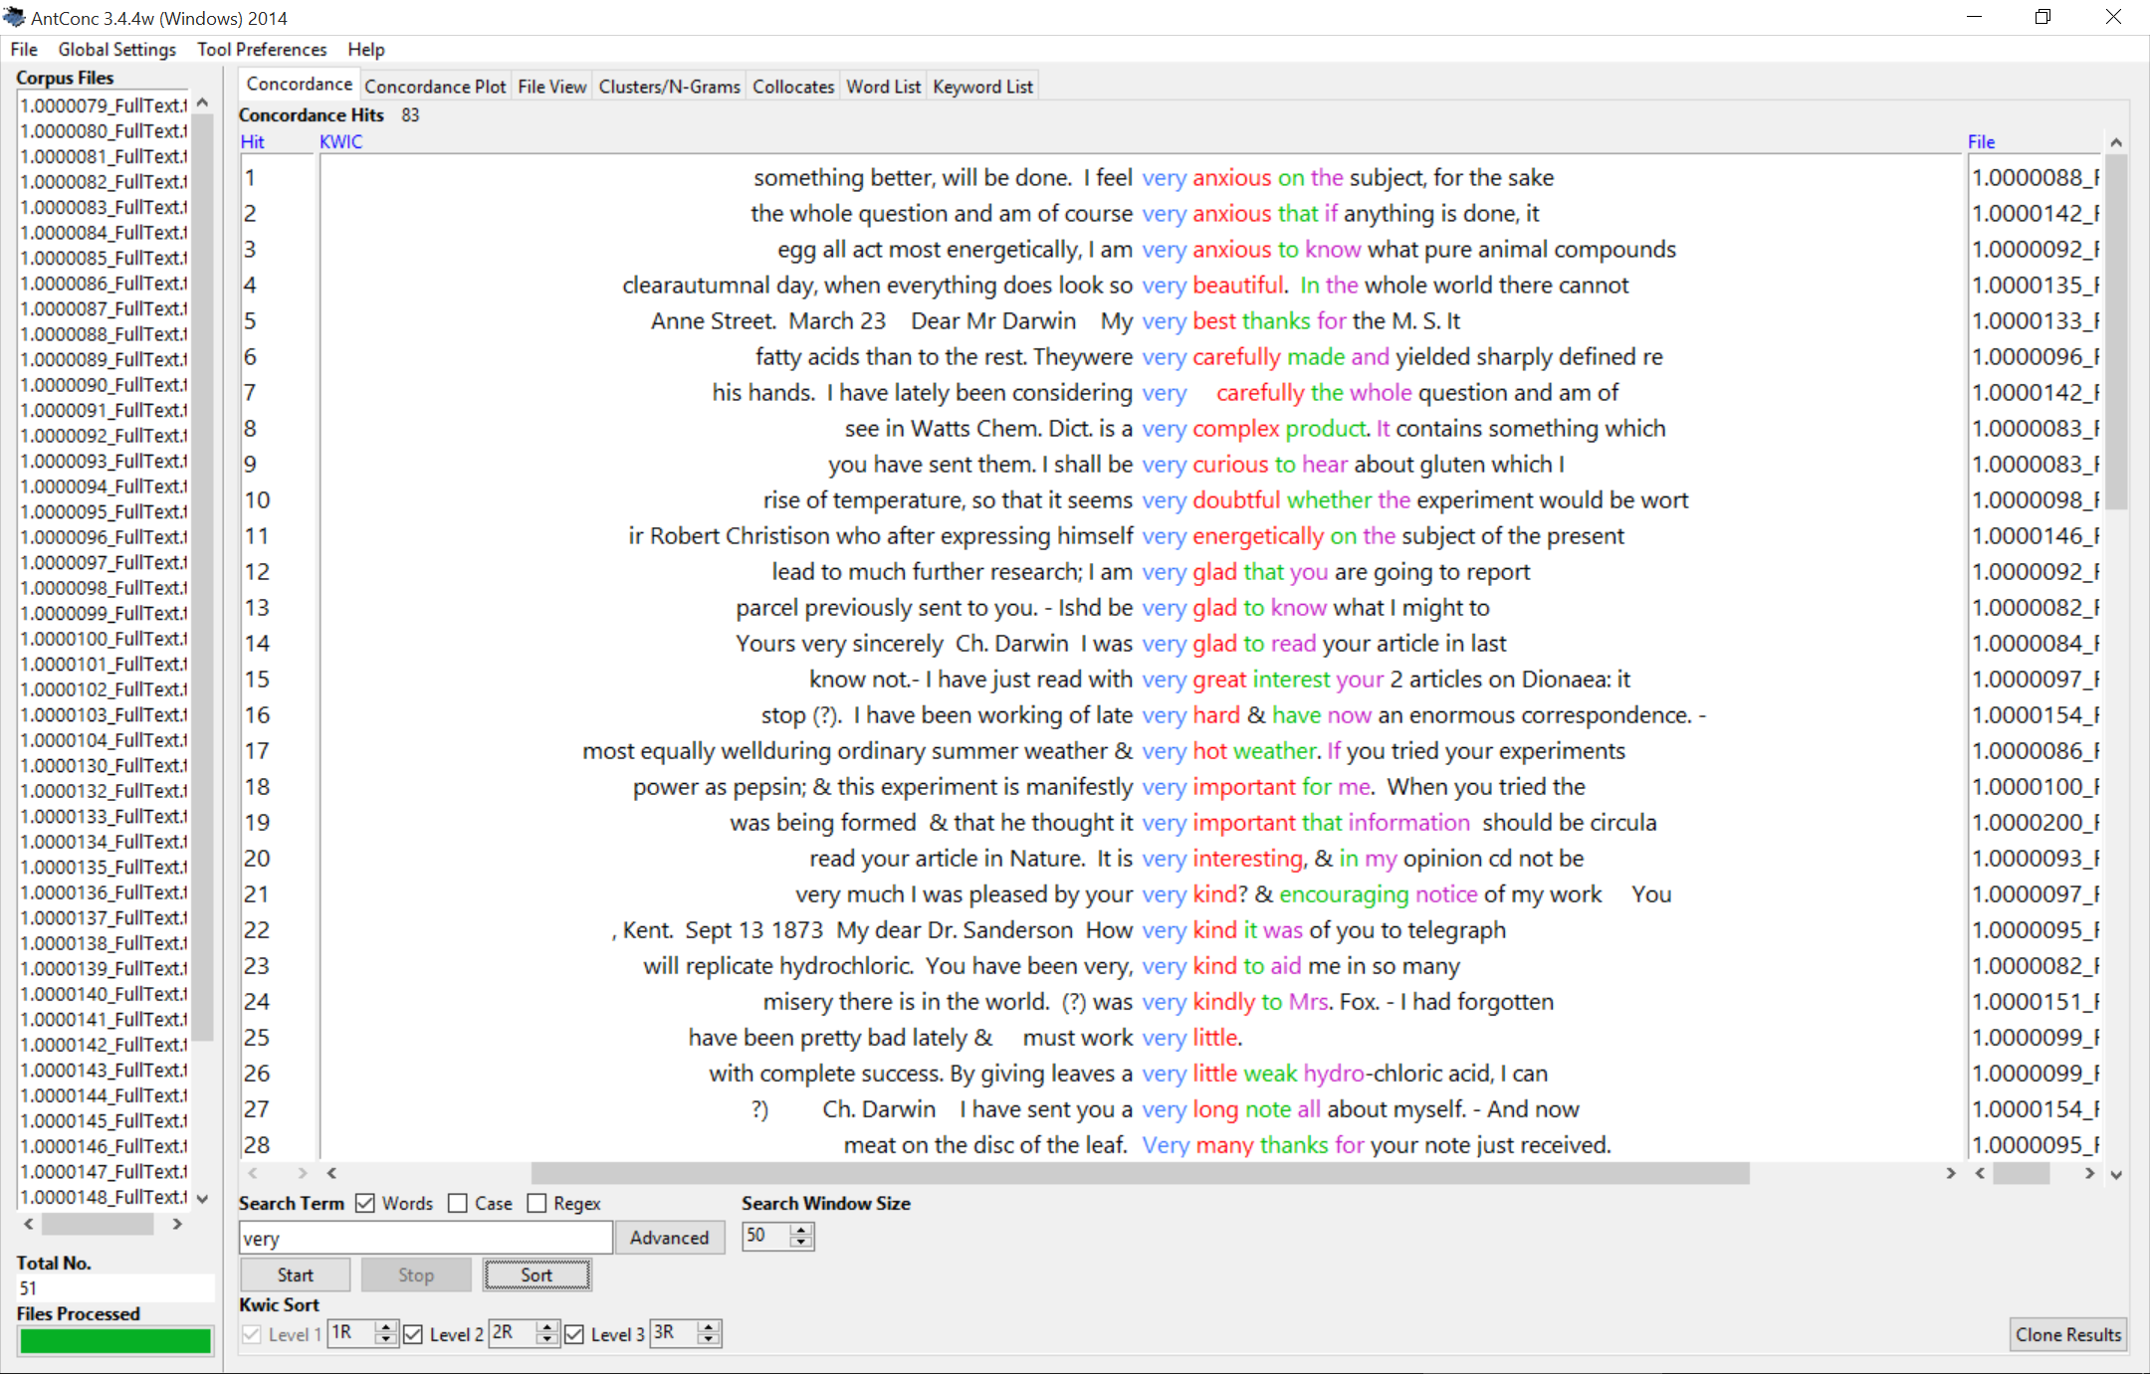
Notes:
This sorts on the first word to the right, then the second word and finally the third word.. Makes results much easier to read through. (scroll next 2)

Slide 40
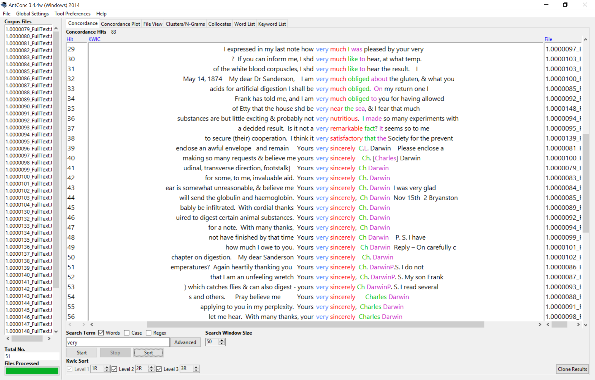

Slide 41
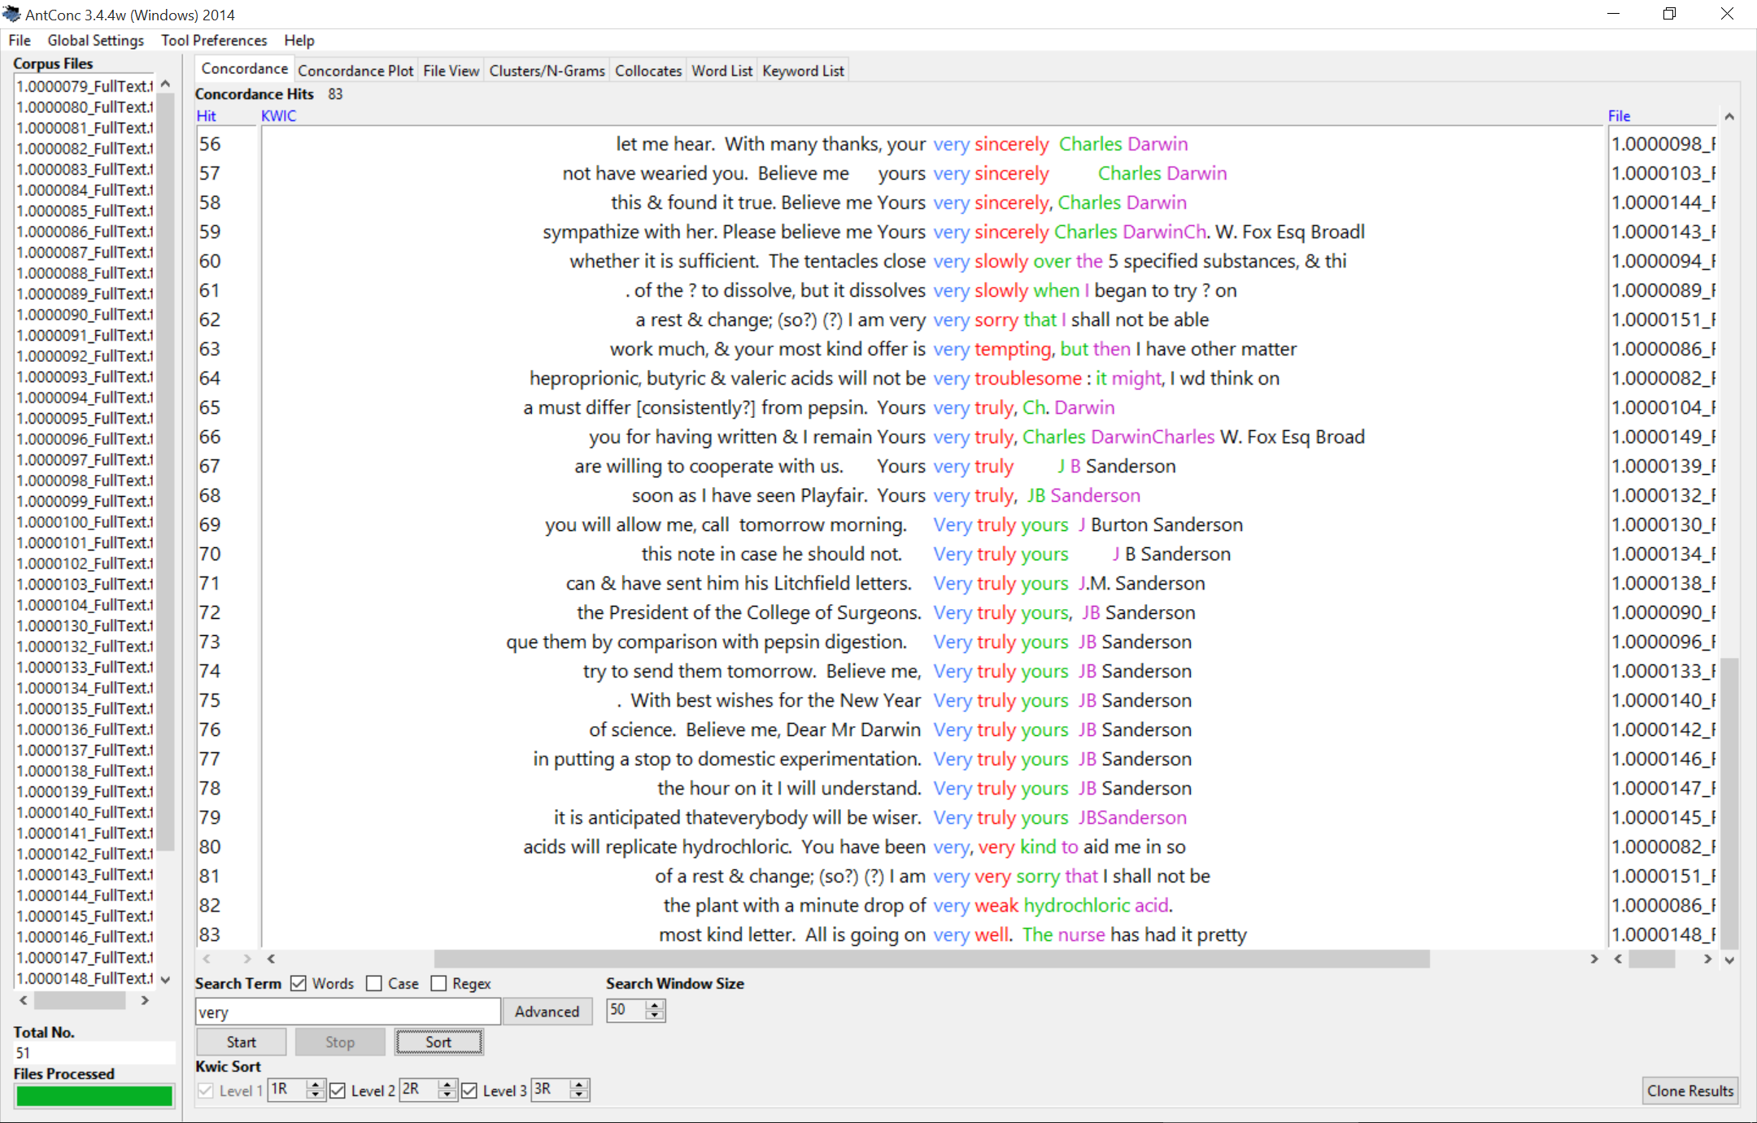

Slide 42
Notes:
If you want to switch the sorting around you can do so from this menu..

Slide 43
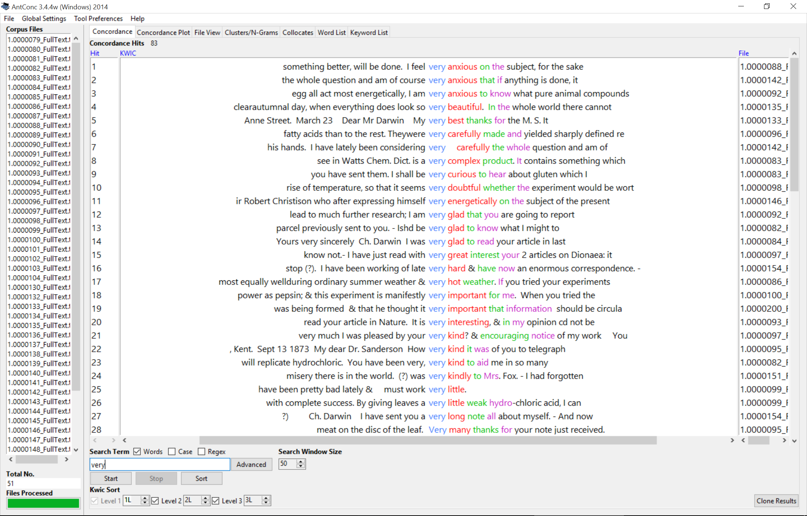
Notes:
You need to enter in 1L 2L 3L to sort in the order of 1st from left, 2nd from left etc, and rehit sort.

Slide 44
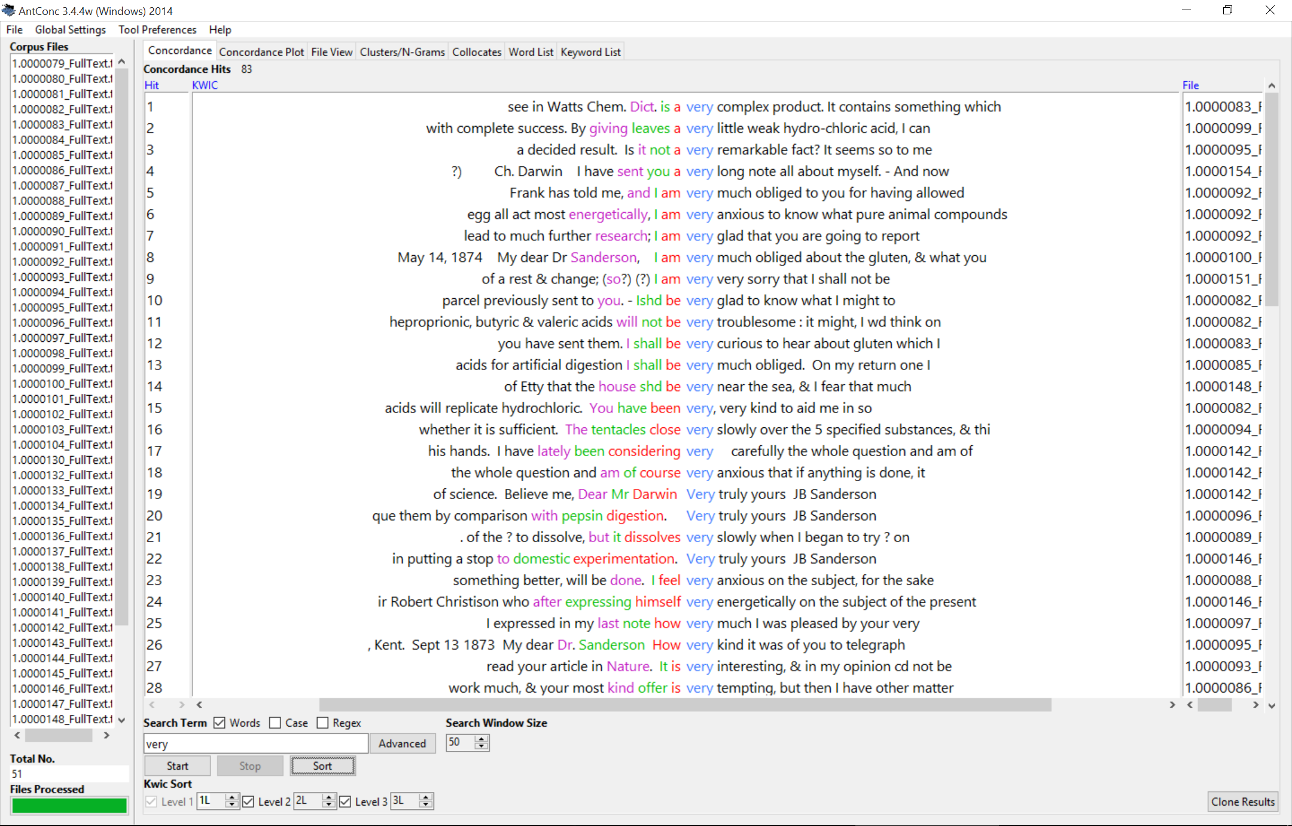
Notes:
Again allows you to quickly see the context in which the word was used. (scroll through next two)

Slide 45
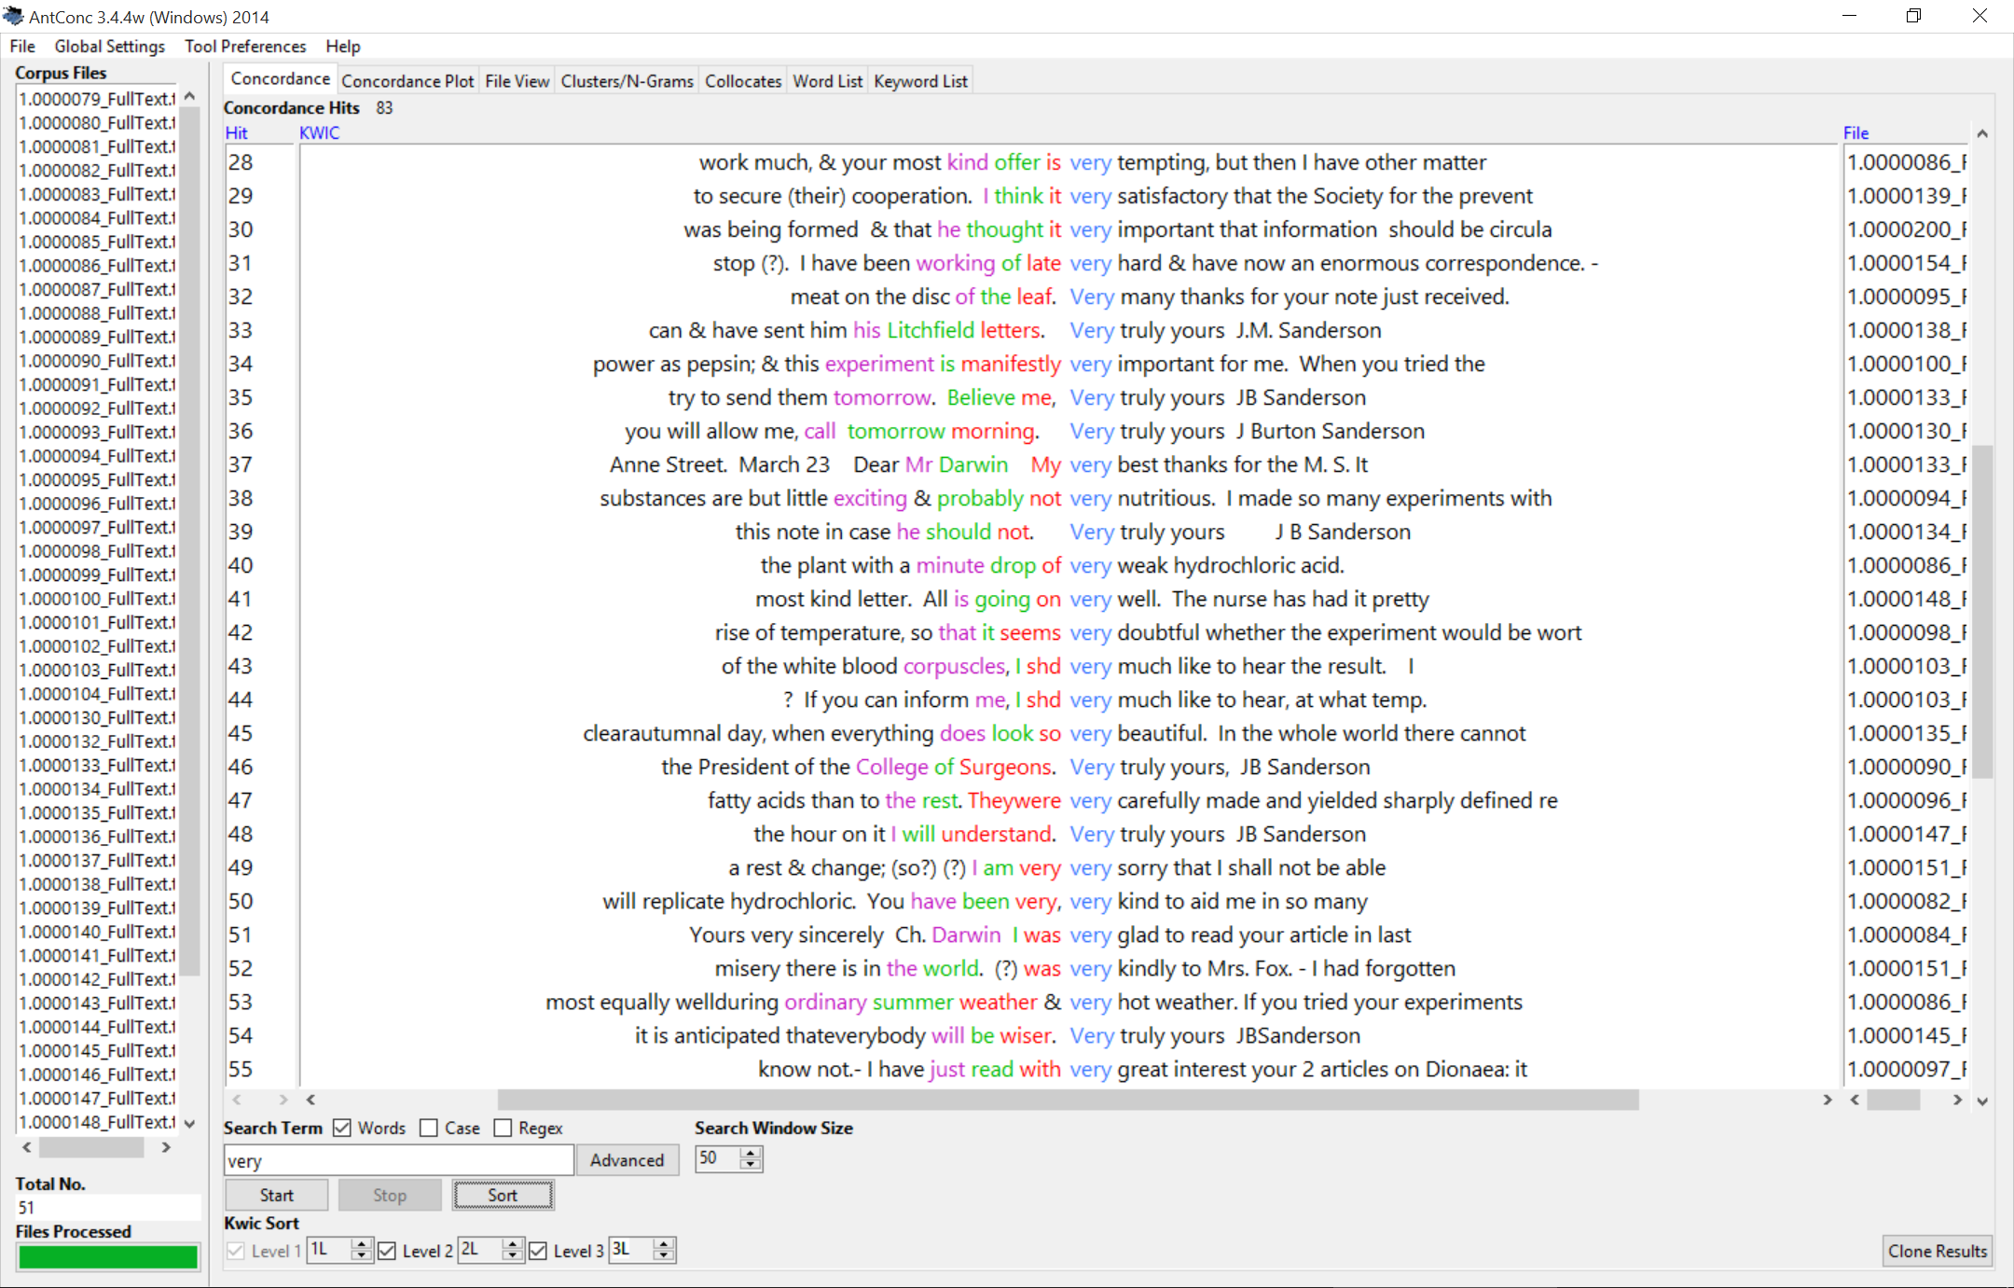

Slide 46
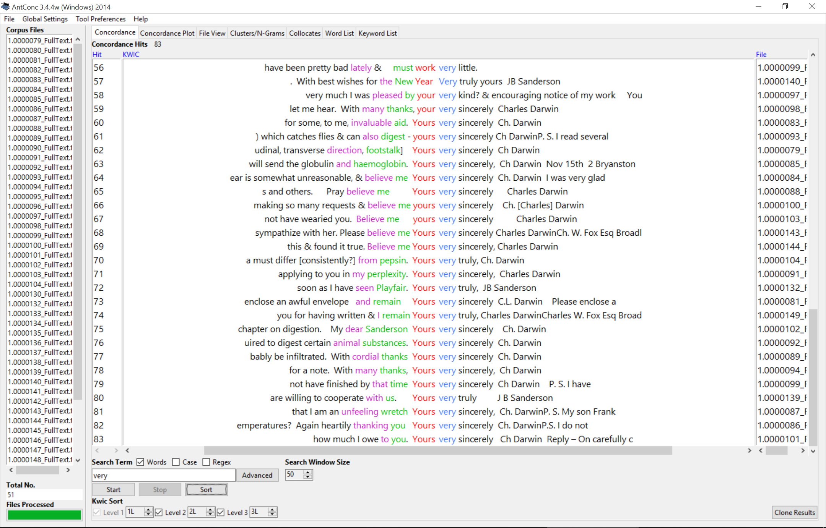
Notes:
Next concordance plot..

Slide 47
Notes:
Click tab, barcode type view

Slide 48
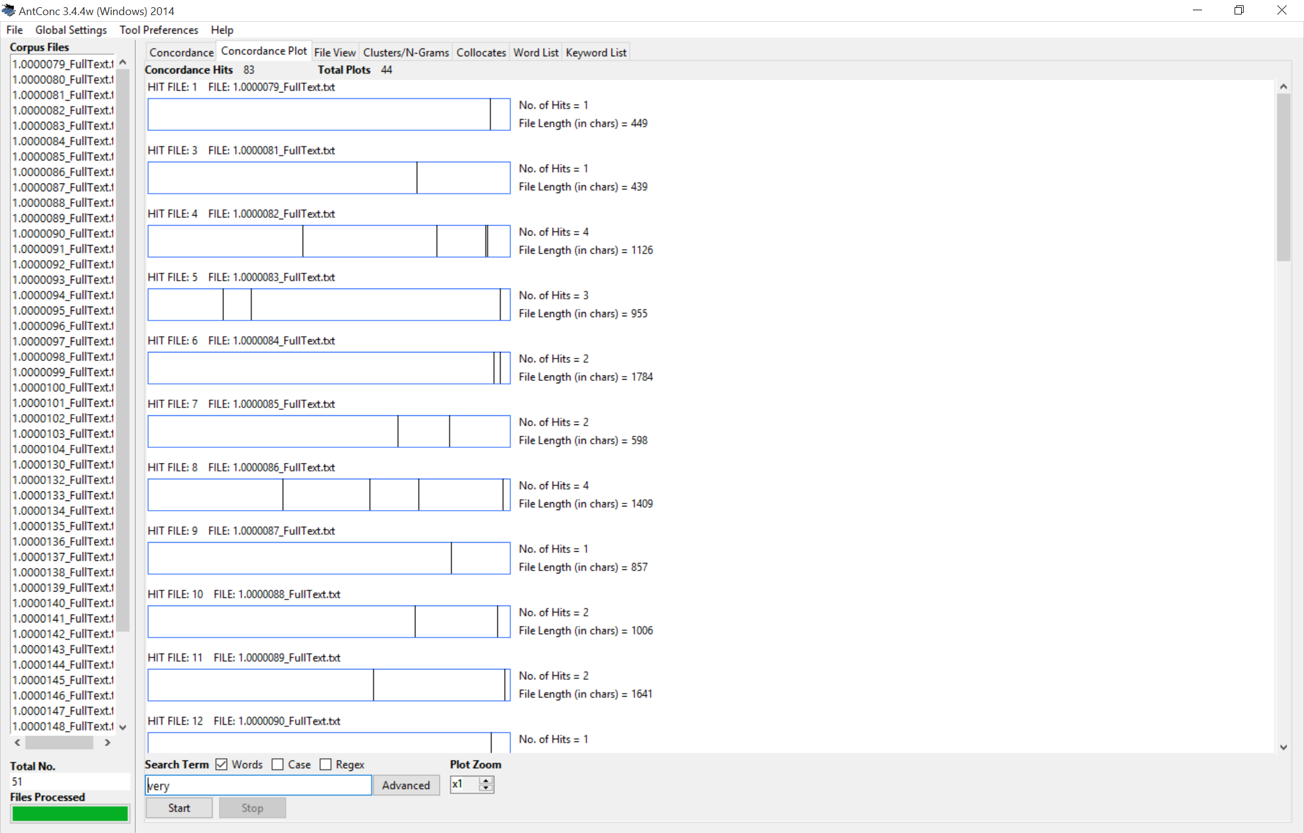
Notes:
Each line related to hit of your search..

Slide 49
Notes:
Each line related to hit of your search..

Slide 50
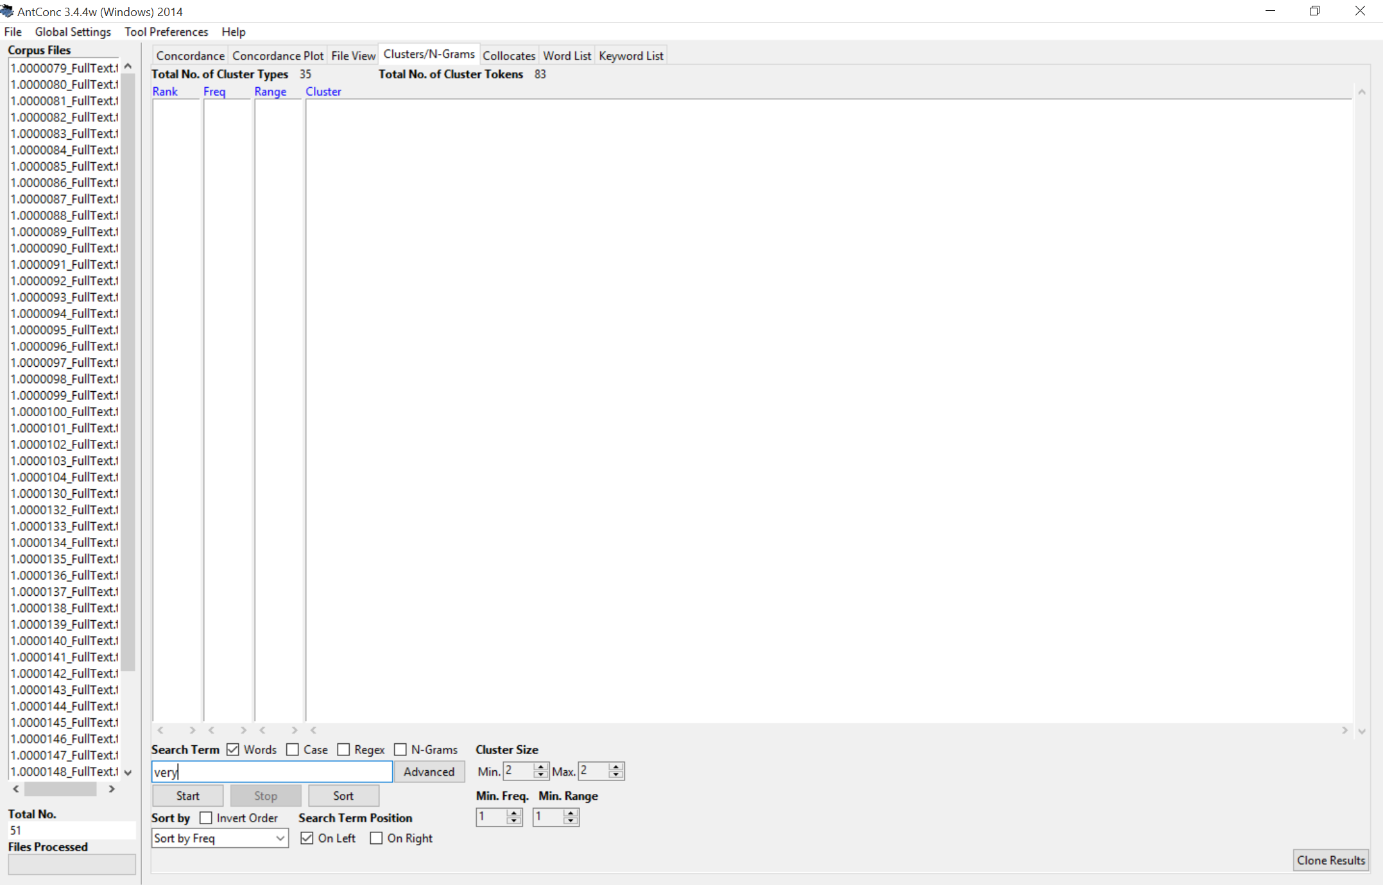

Slide 51
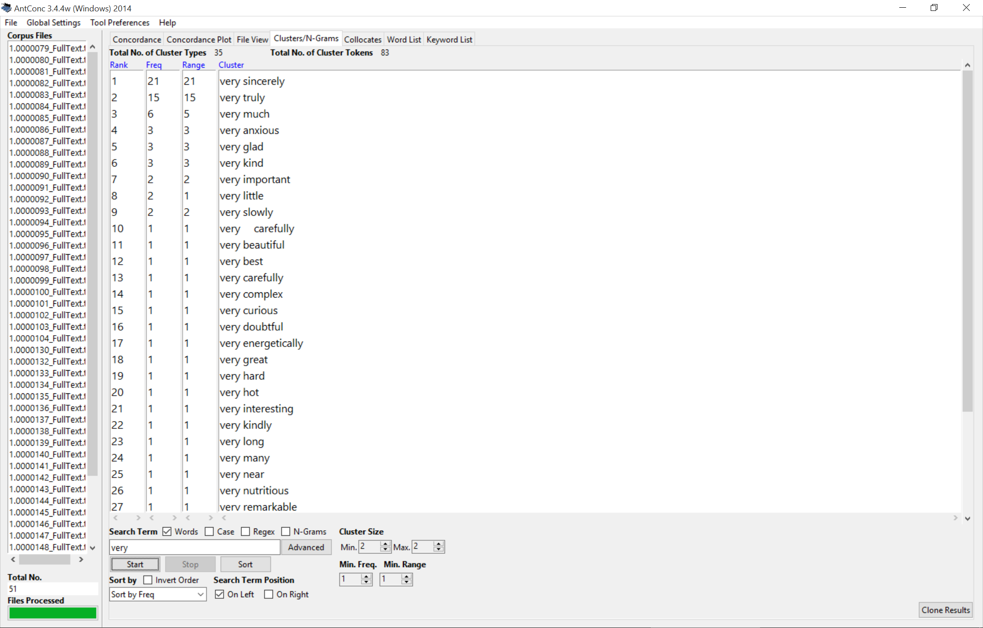

Slide 53
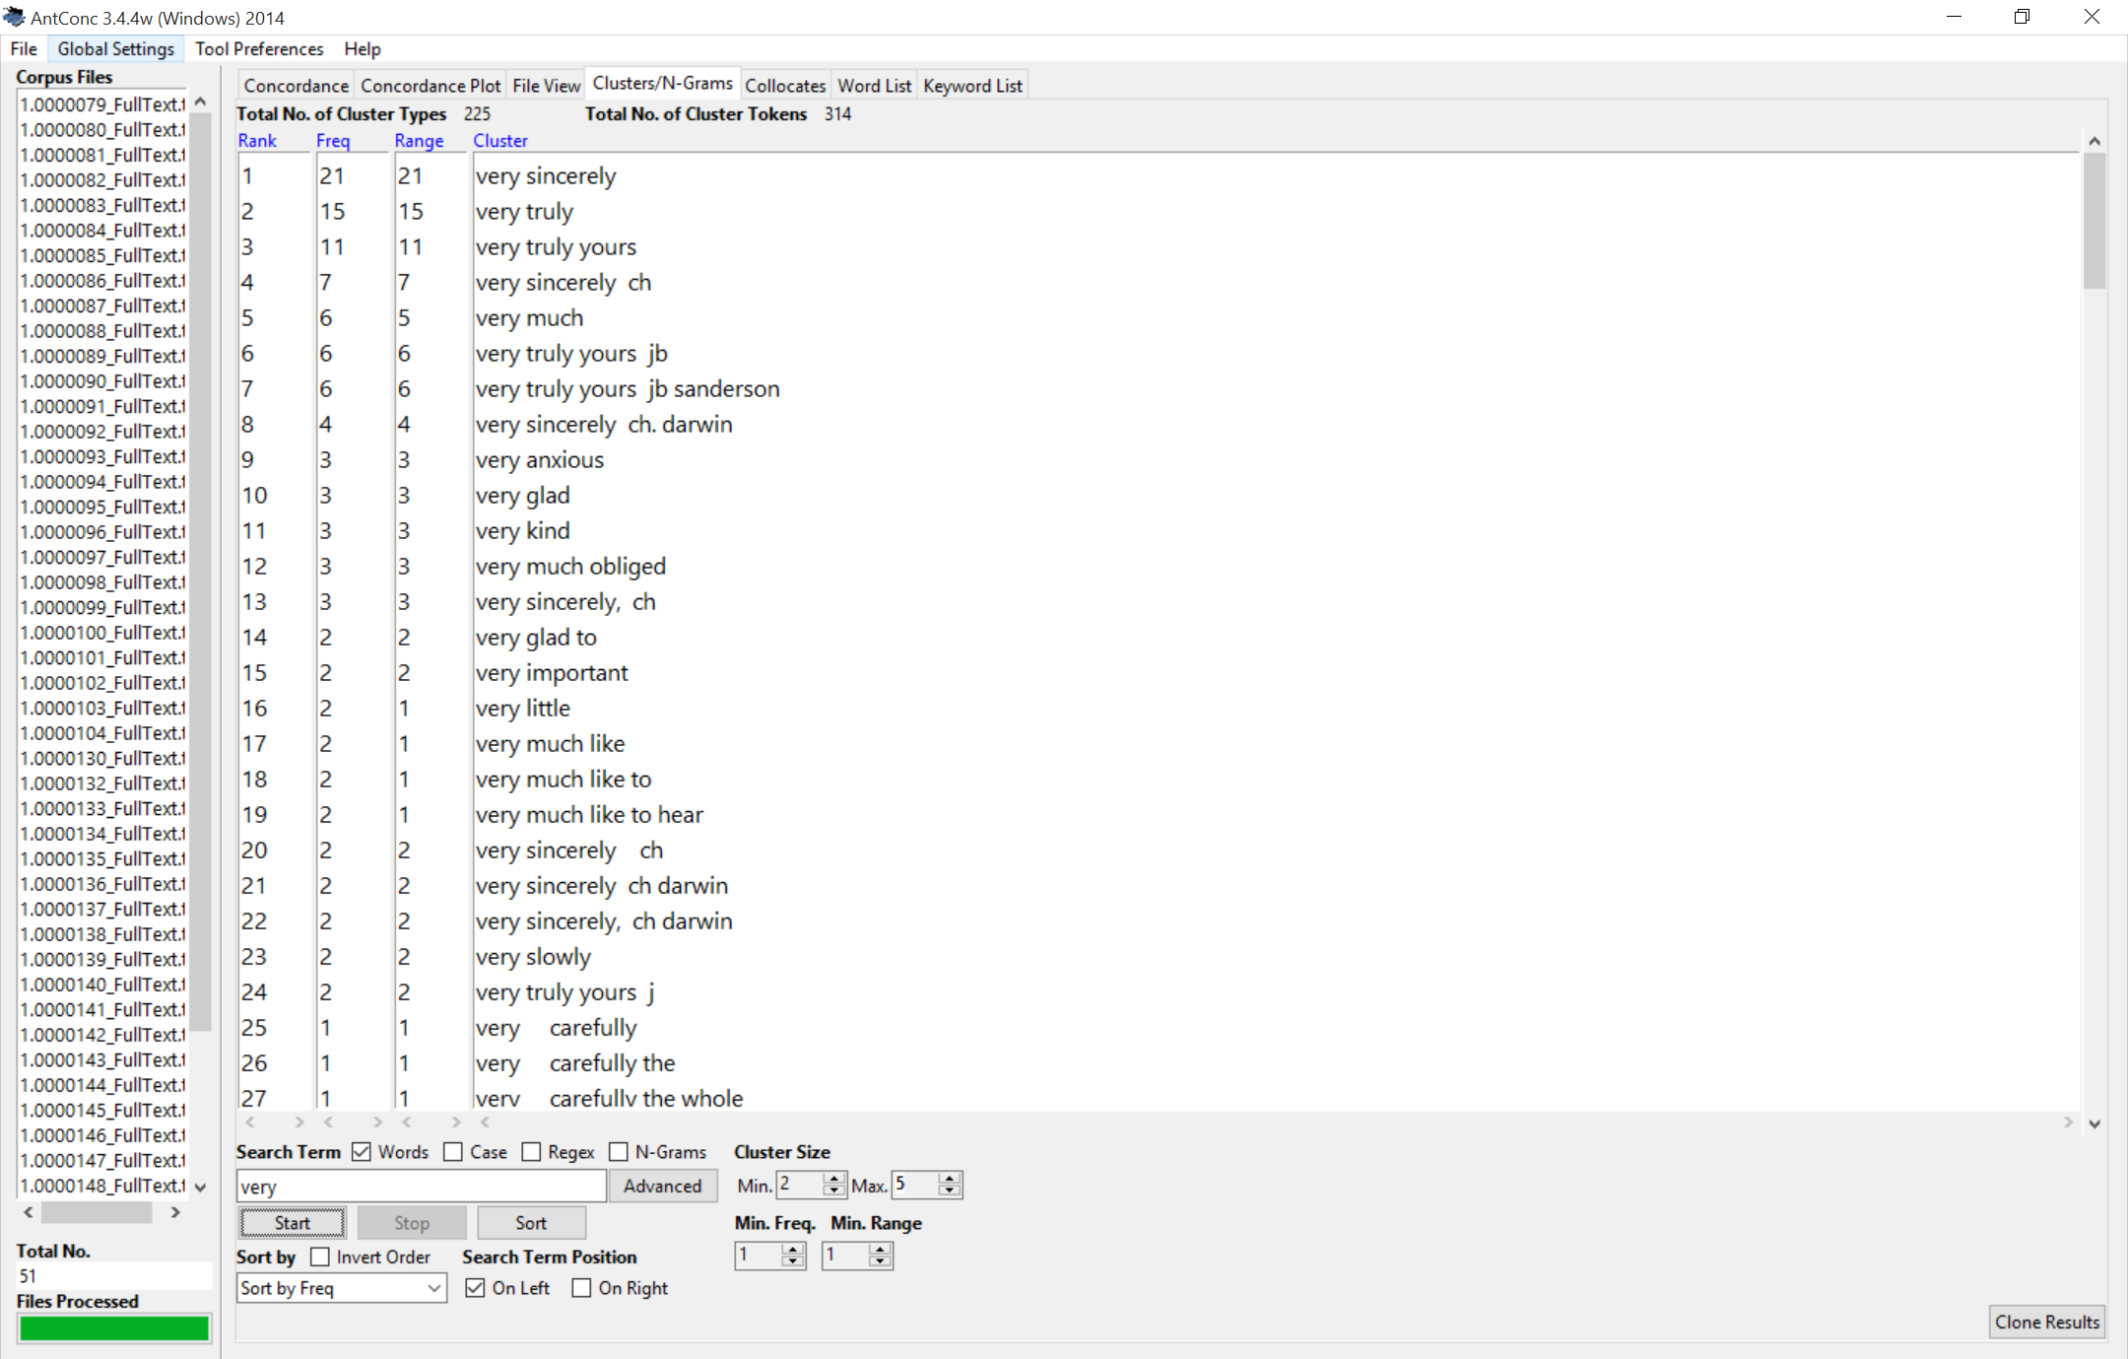

Slide 55
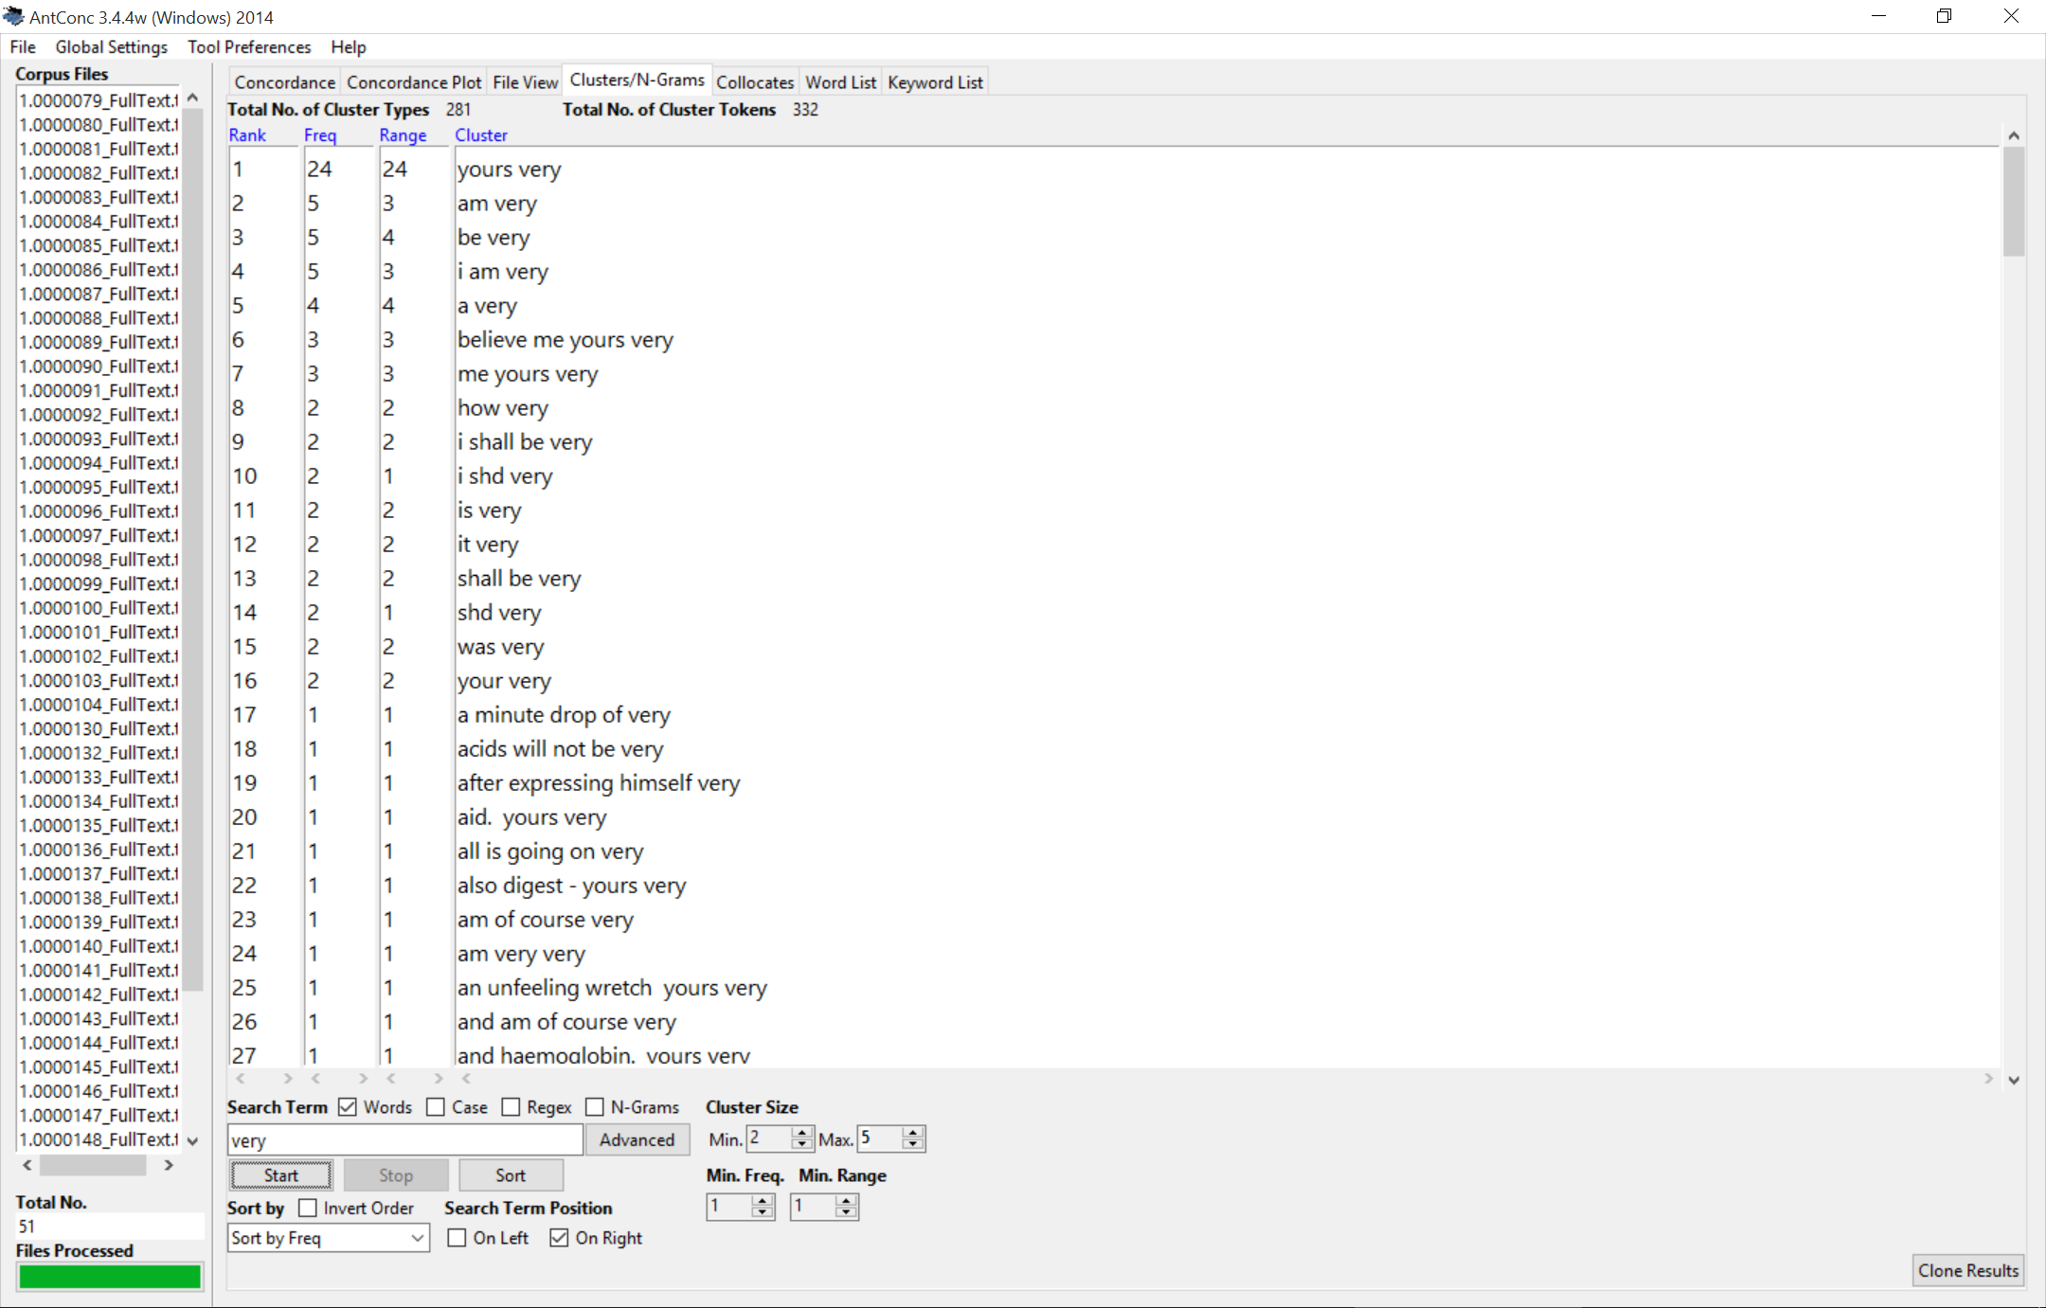

Slide 56
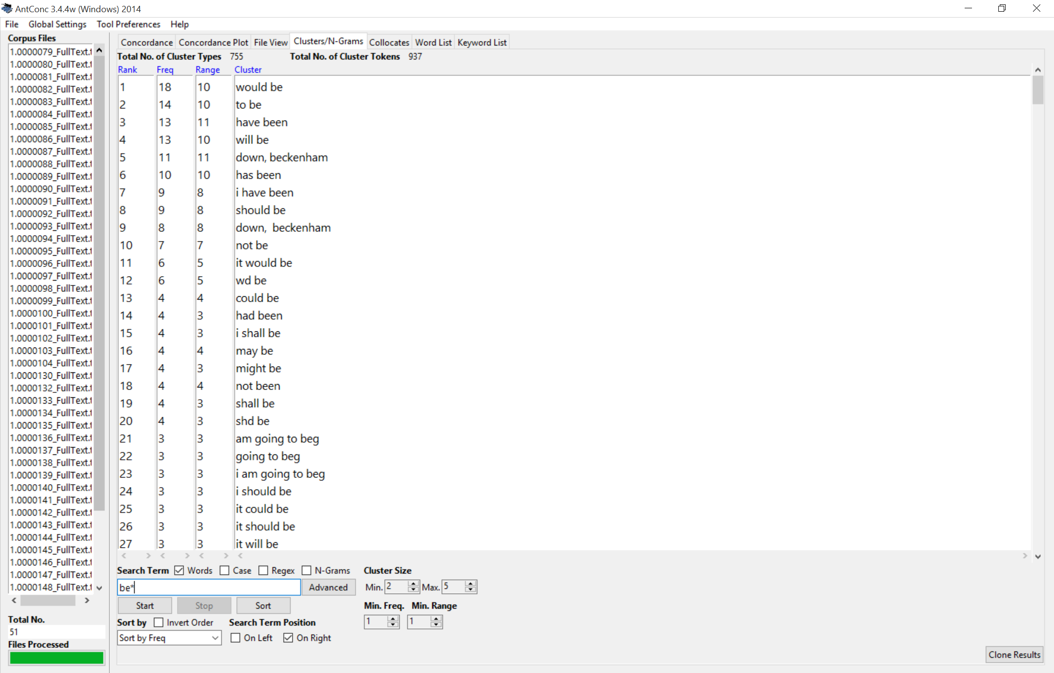

Slide 57
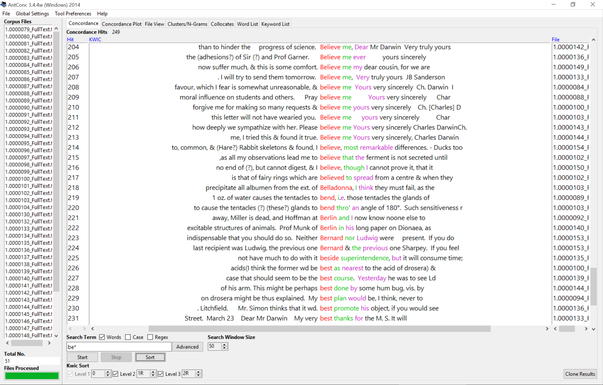

Slide 58
Python & NLTK via Jupyter
Python – An interpreted, object-oriented, high-level programming language with dynamic semantics.
NLTK – A platform for building Python programs to work with human language data.
Jupyter – A web application that allows you to create documents that contain live code..
http://tinyurl.com/oc-full-text
Notes:
http://localhost:8888/

Slide 59

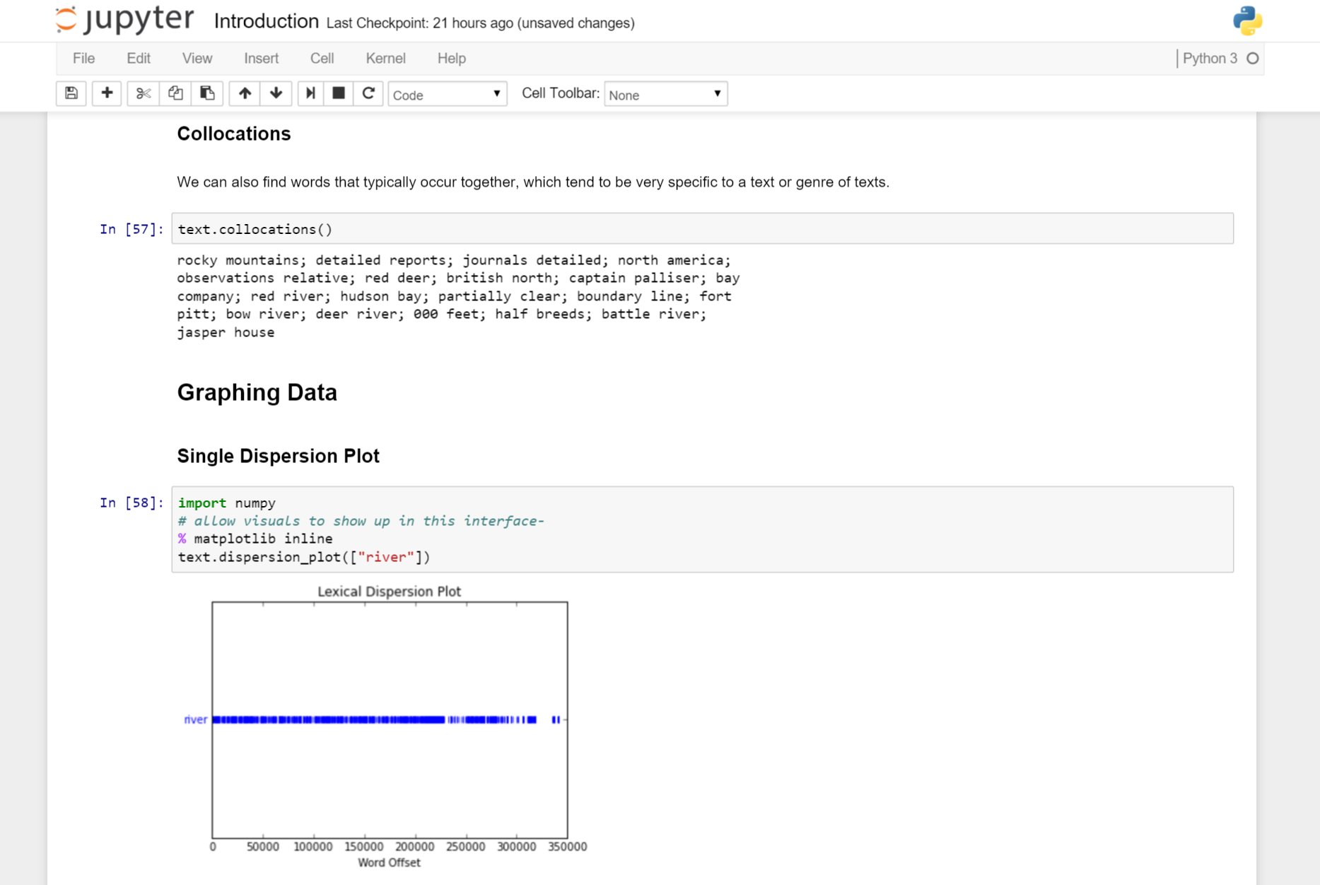
http://tinyurl.com/oc-full-text

Slide 60
Thank you!
Follow me @mrseanmcn

